Slide 1



Course Project 1: A subfamily classification to choreograph the diverse activities within CAZyme families
Siva Shanmugam (Postdoc)
Xinpeng Zhang (PhD student)
Department of Food Science and Technology
9/21/2023
PI: Yanbin Yin
Notes:
Good afternoon! I’ Xinpeng Zhang from the University of Nebraska-Lincoln. Thank you for the opportunity. Today I will talk about our bioinformatics tools for CAZyme genome mining.

Slide 2
In this project, we will do CAZyme subfamily classification following a recent paper:
DOI: https://doi.org/10.1016/j.jbc.2023.103038
We will use GH31 as an example to show all analyses
Students will form two groups to work together on GH5 (group 1) or GH16 (group 2)

Slide 3
Part I Data preparation

Slide 4
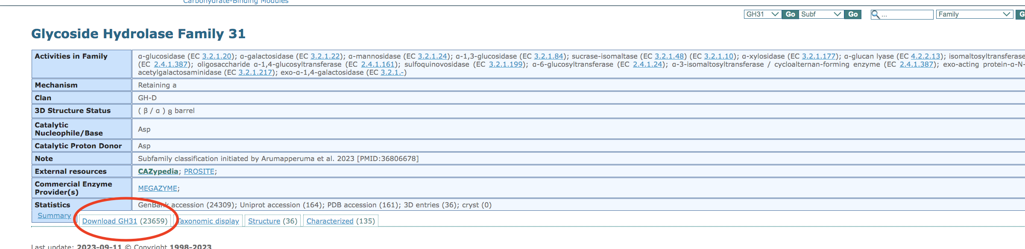
Go to the CAZy website. http://www.cazy.org/
Select GH classes on CAZy database. http://www.cazy.org/Glycoside-Hydrolases.html
Choose GH31 (change into your family). http://www.cazy.org/GH31.html
Find the txt file containing IDs.

Slide 5
Log in your swan OnDemand and download all data to the work folder.
cd $WORK
mkdir course_project
cd course_project
git clone https://github.com/sivanr92/Class_project.git
For each part, we recommend to create a folder and named with “part1”, “part2” ...
mkdir part1
cd part1
*Remember to do that and we won’t show it again in the next slides.
*NEVER forget which folder you are in and which you should be.

Slide 6
Copy the link and use the wget to download it on swan.
wget http://www.cazy.org/IMG/cazy_data/GH31.txt
Use GH31.txt to get a list of genbank ids of GH31 family.
cut -f 4 GH31.txt > list_ids.txt
Remove the redundant IDs.
cat list_ids.txt | sort |uniq > uniq_list_ids.txt
You will get 24307 unique ids in GH31.
wc -l uniq_list_ids.txt

Slide 7
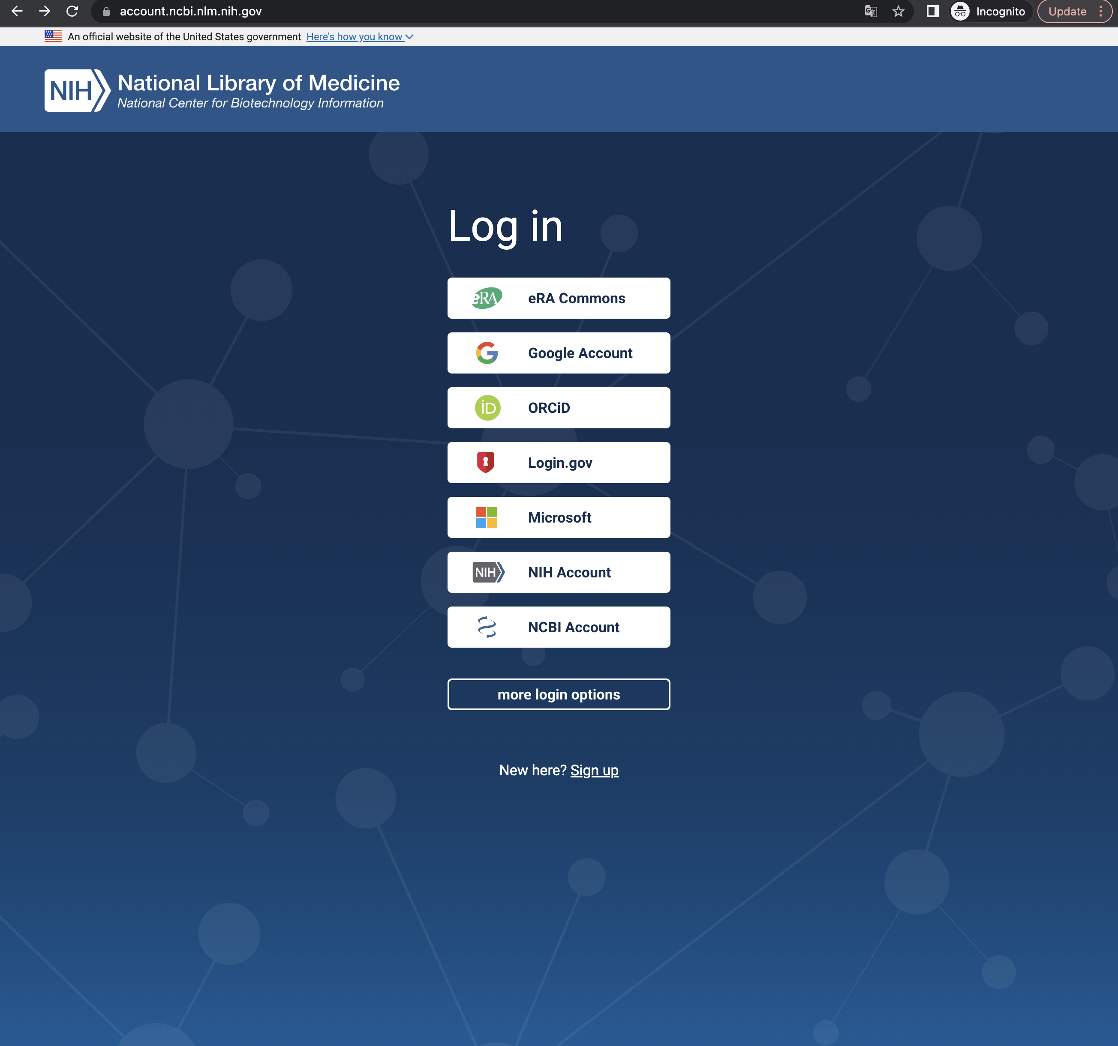
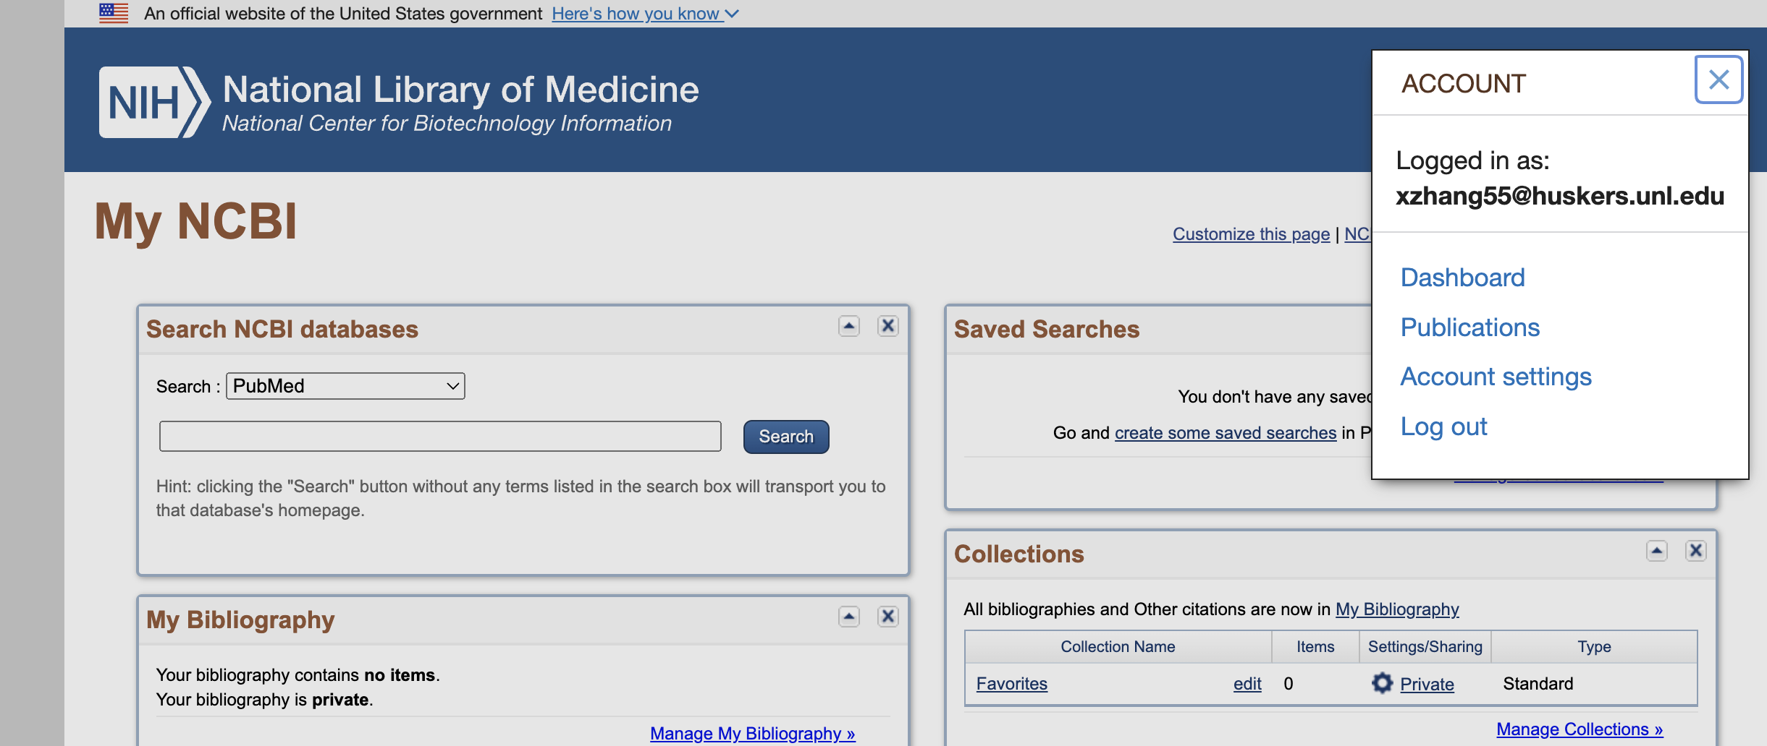
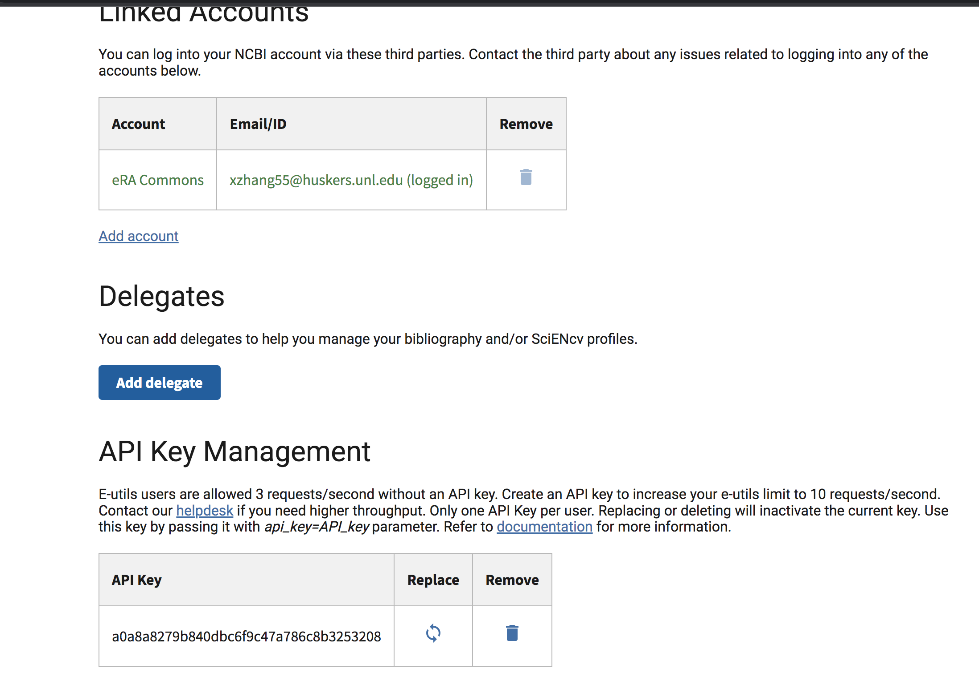
To download the sequences from the NCBI programmatically, use the batch service available from NCBI Entrez Direct: E-utilities.
Go to the website firstly to sign up an account (use anything you like, recommend to use the UNL account).
https://account.ncbi.nlm.nih.gov/
Then go to the “Account settings”
Find your API key in the end.
https://www.ncbi.nlm.nih.gov/books/NBK179288/

Slide 8
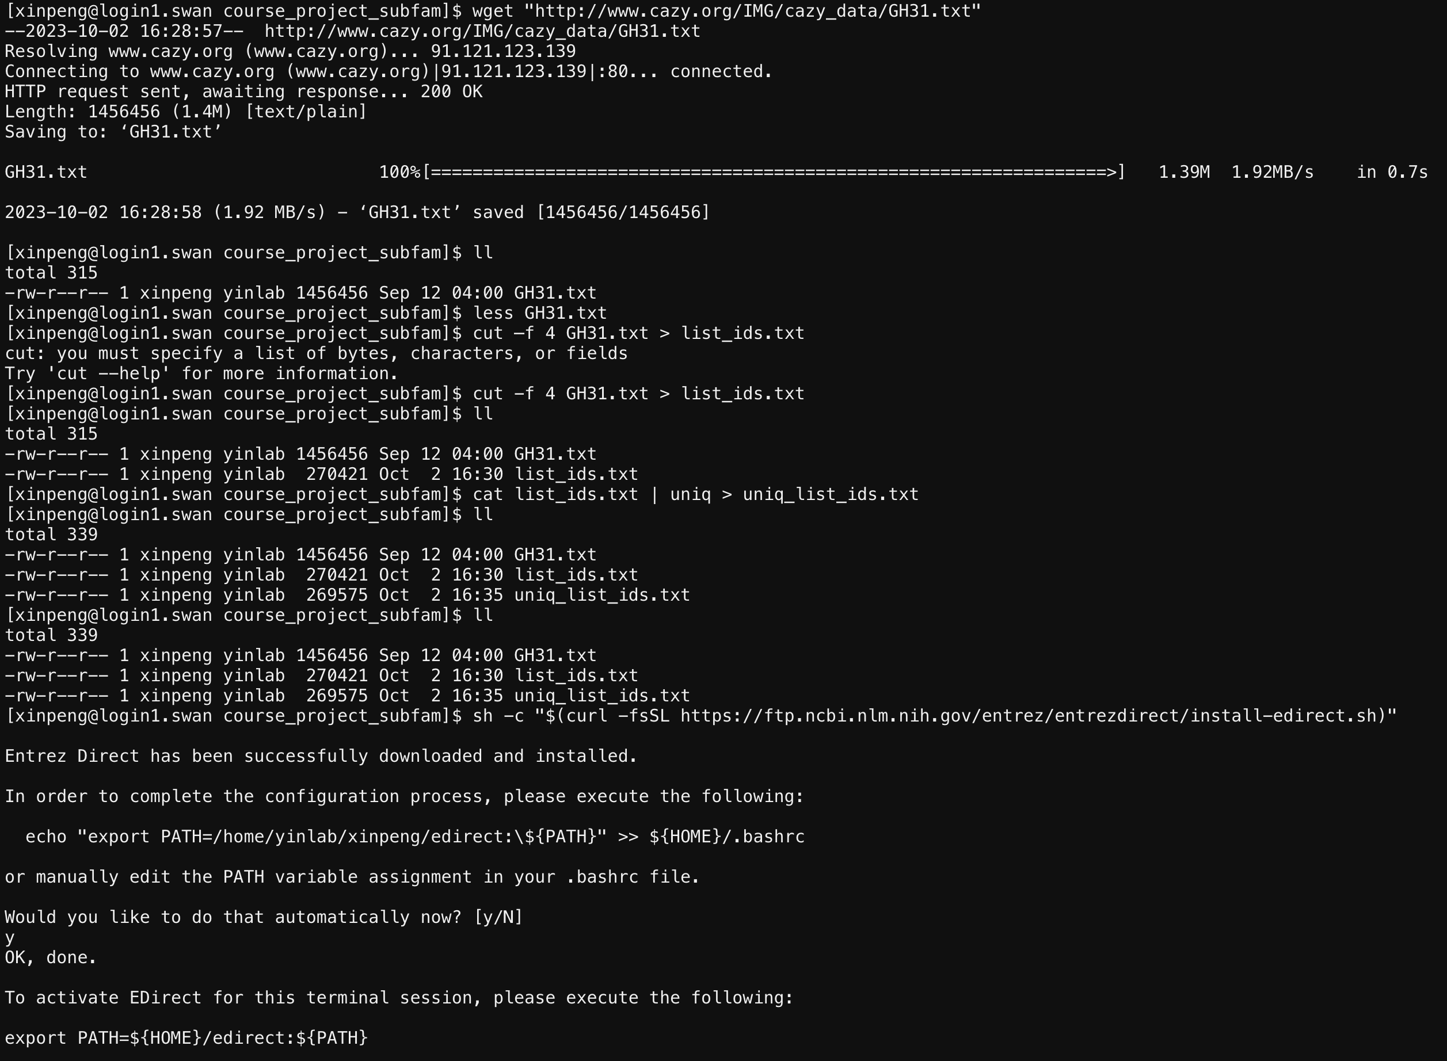
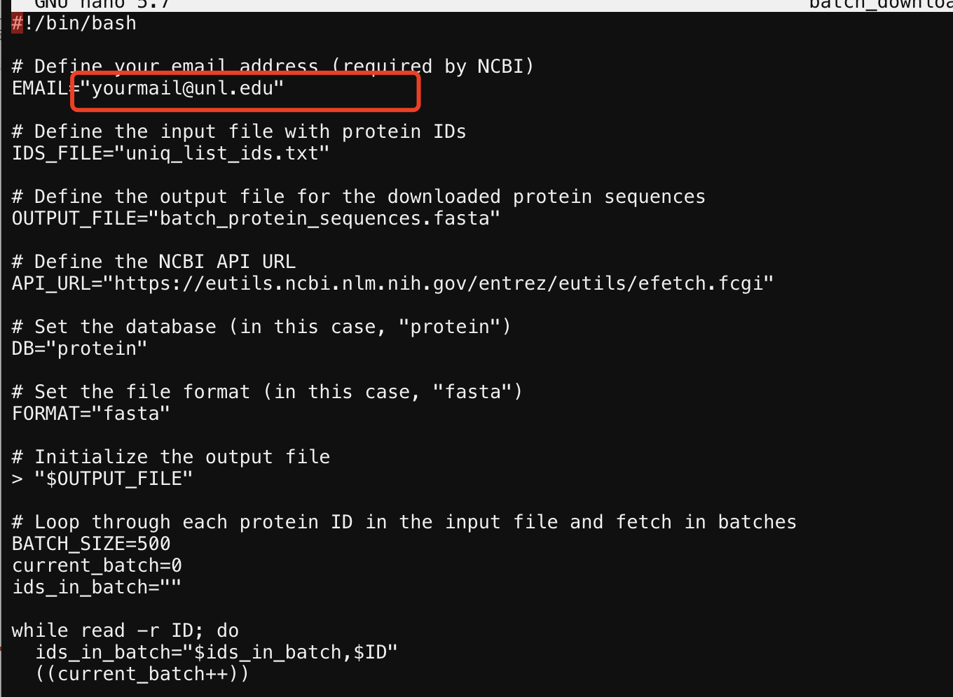
Run the following command:
sh -c "$(curl -fsSL https://ftp.ncbi.nlm.nih.gov/entrez/entrezdirect/install-edirect.sh)
(Type y and click enter when it asks you to do it)
And use this command to set your NCBI API key
export NCBI_API_KEY= your_API_KEY
cp ../Class_project/batch_download_protein_seqeunces.sh .
nano batch_download_protein_seqeunces.sh
Revise to change email address
The uniq_list_ids.txt file will be processed for this sh script

Slide 9
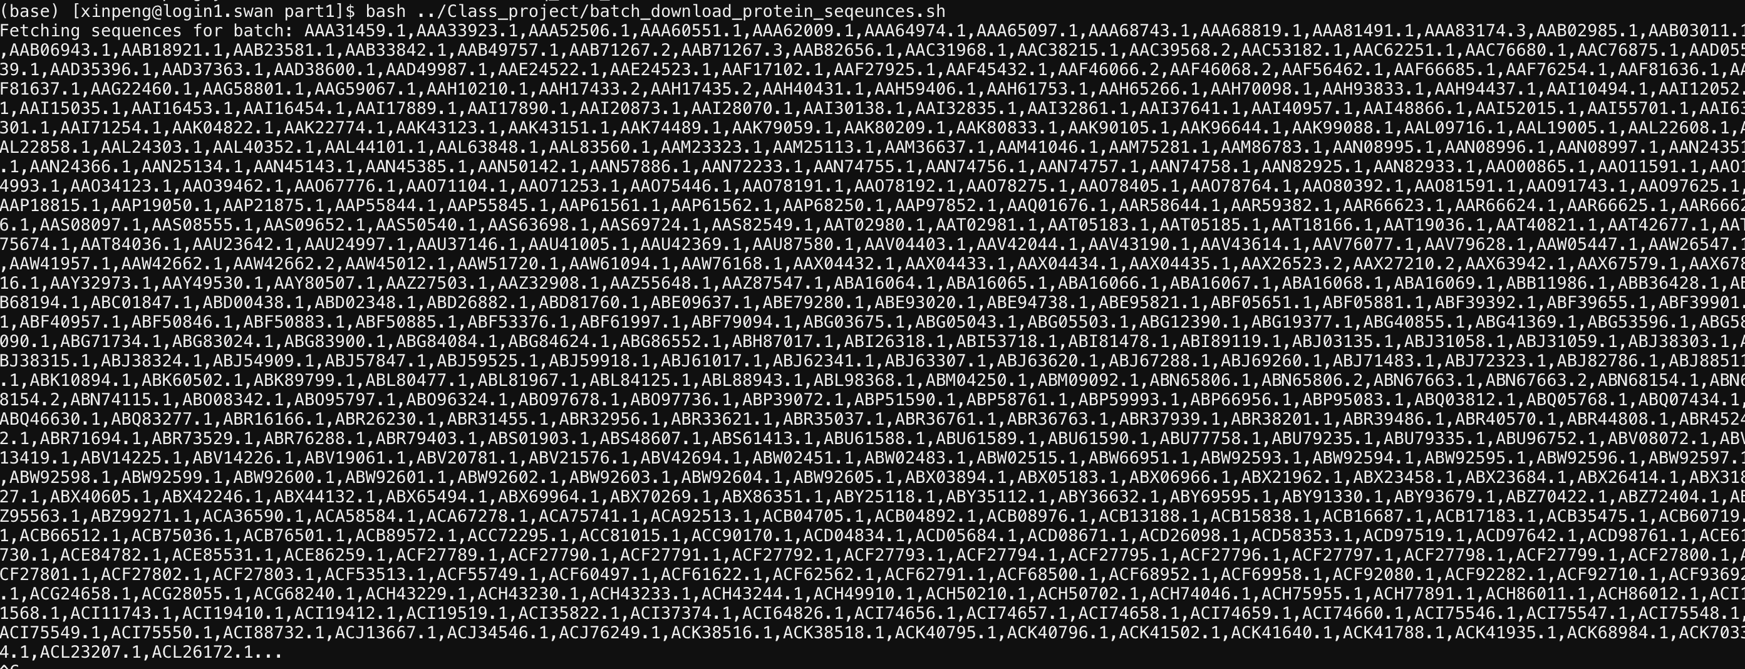
After that
bash batch_download_protein_seqeunces.sh
It takes me ~30mins to downloading data.
24306 ids were found and downloaded.
Finally you get a file called “batch_protein_sequences.fasta”.

Slide 10
Part II Domain annotation
Create your part2 folder

Slide 11
Go to the website:
https://bcb.unl.edu/dbCAN2/download/Databases/dbCAN-old@UGA/
Use wget to download “dbCAN-fam-HMMs.txt” and “hmmscan-parser.sh”
Use module load to activate hmmer on swan.
ml hmmer/3.3
hmmbuild -h #To check if it works or not.

Slide 12
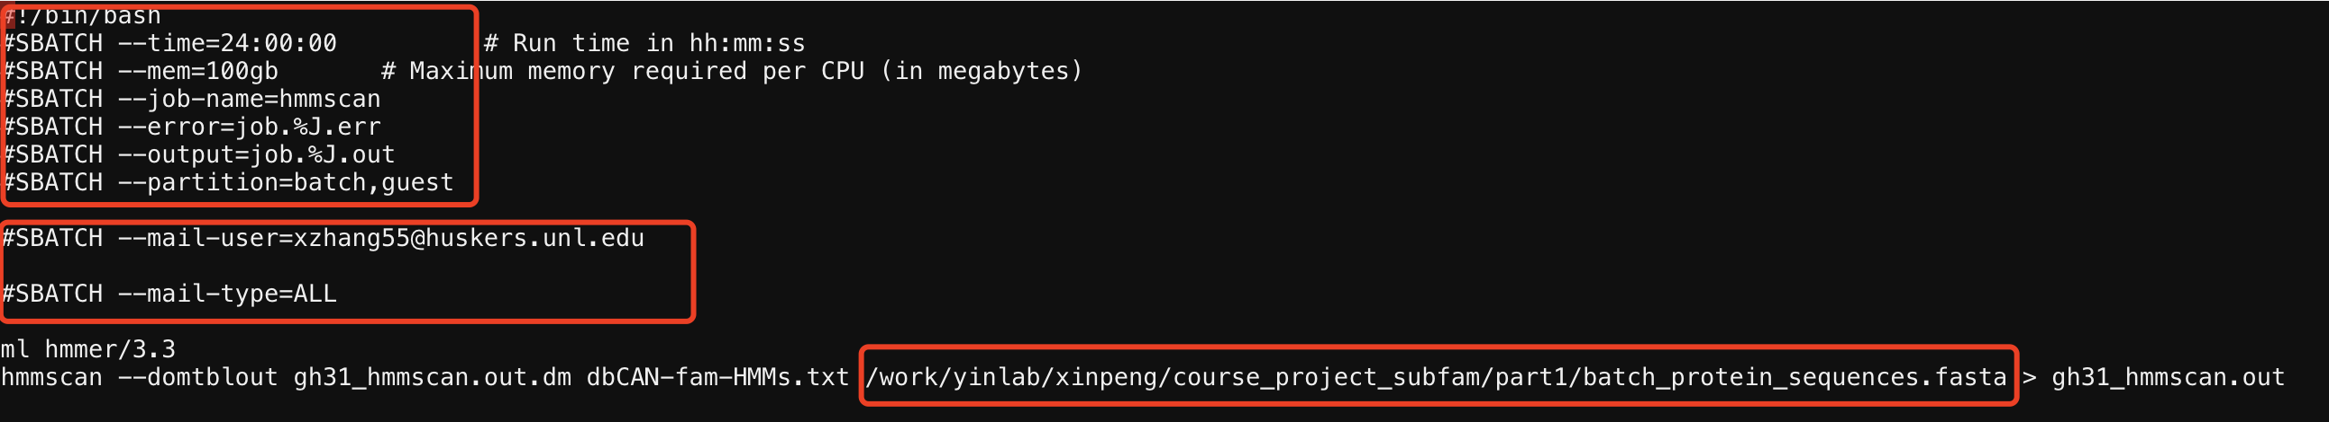
Then make the hmm database files:
hmmpress dbCAN-fam-HMMs.txt
cp ../Class_project/hmmscan_run.slurm .
nano hmmscan_run.slurm
Edit it using your own info.
Try smaller mem if the waiting time is too long.
Set error and output with the same path (in your part2 folder).
Add email to remind you when it start/stop.
Remember where you have your GH31 protein sequence files.
It takes me ~4hrs

Slide 13
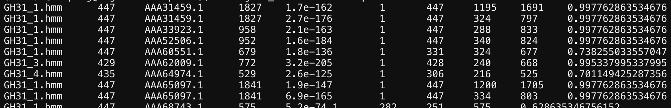
Run the following commands to make the result readable
sh hmmscan-parser.sh gh31_hmmscan.out.dm > gh31_hmmscan.out.dm.ps
And extract the final modules by filtering with E- Value <1e-15 and coverage cut off >0.35.
cat gh31_hmmscan.out.dm.ps | awk '$5<1e-15&&$10>0.35' > gh31_hmmscan.out.dm.ps .stringent
Columns in yourfile.out.dm.ps: 1. Family HMM 2. HMM length 3. Query ID 4. Query length 5. E-value (how similar to the family HMM) 6. HMM start 7. HMM end 8. Query start 9. Query end
10. Coverage

Slide 14
Part III Domain extraction
Create your part3 folder

Slide 15
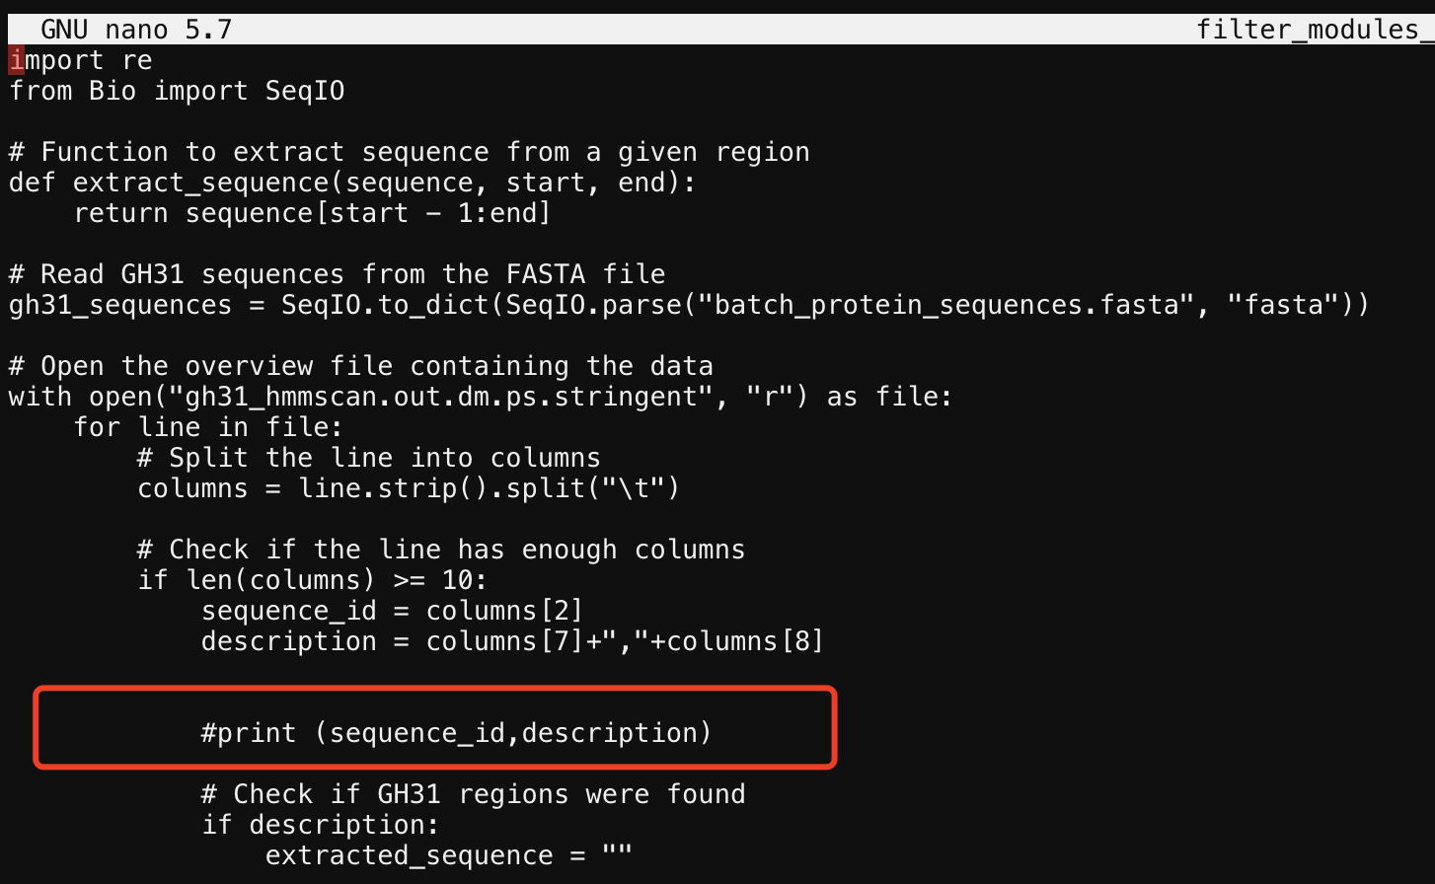
We give a python file to do that. First activate the biopython.
ml biopython
cp ../Class_project/filter_modules_26sep2023.py .
cp ../part1/batch_protein_sequences.fasta .
cp ../part2/gh31_hmmscan.out.dm.ps.stringent .
python filter_modules_26sep2023.py > extracted_domains.faa
Add “#” here if you didn’t get a fasta format file.

Slide 16
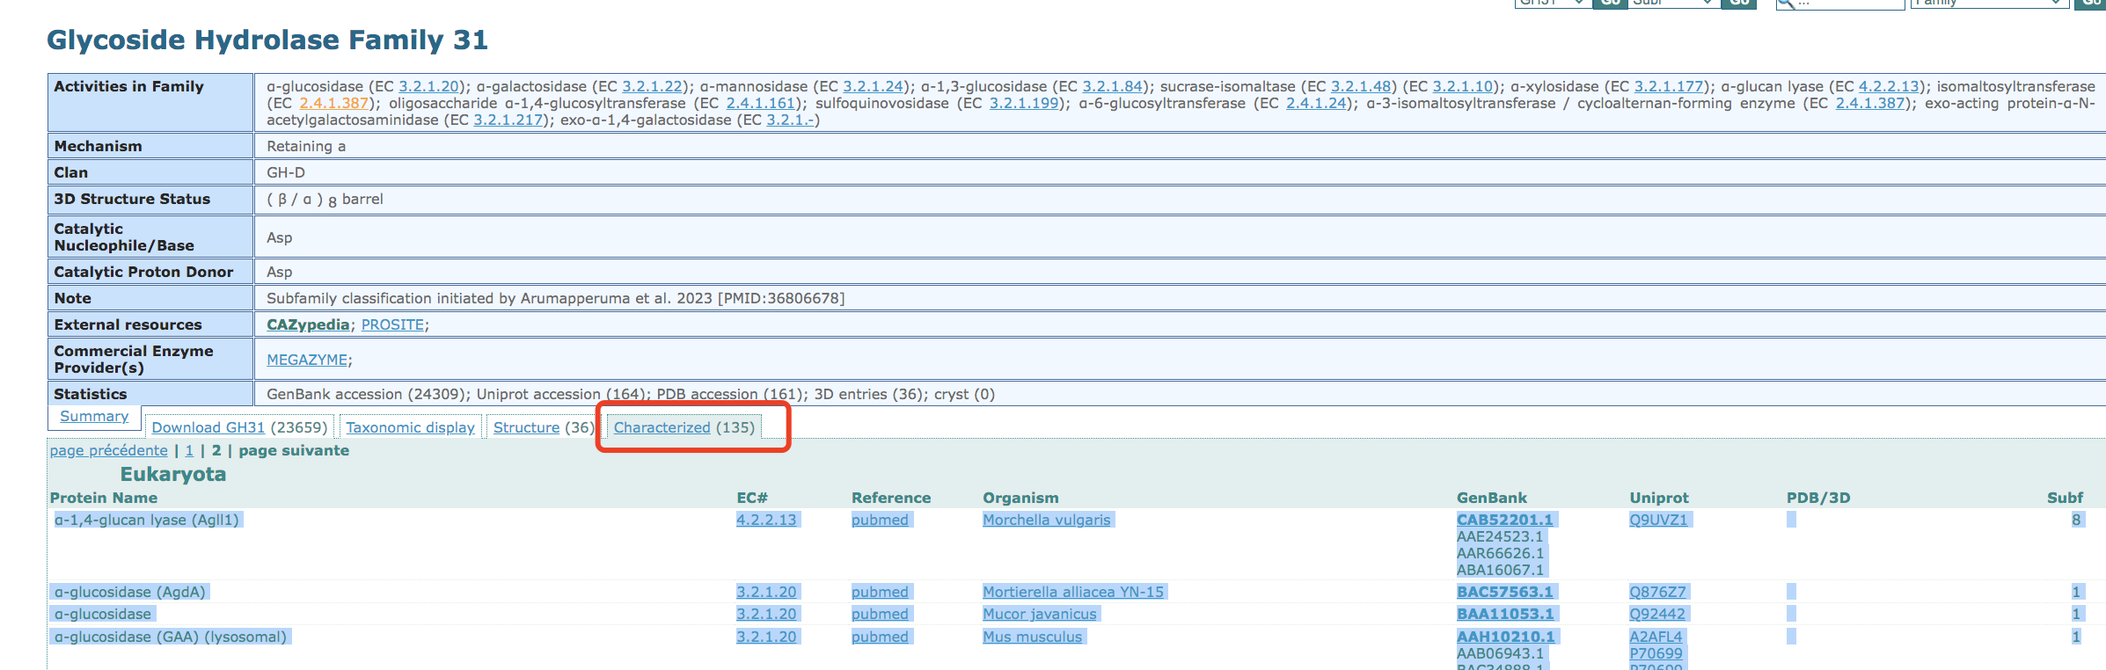
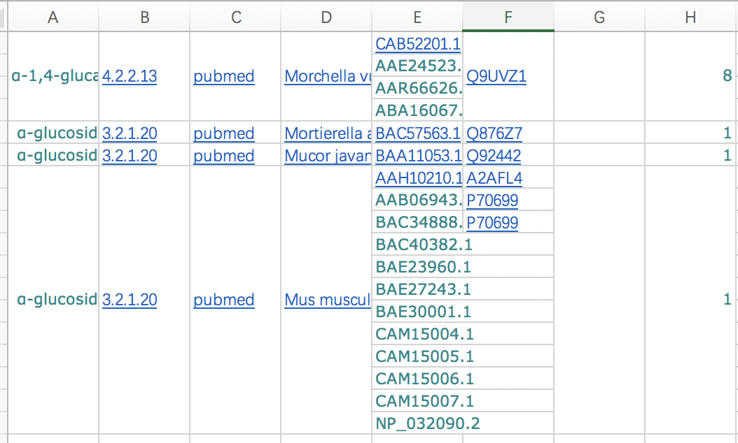
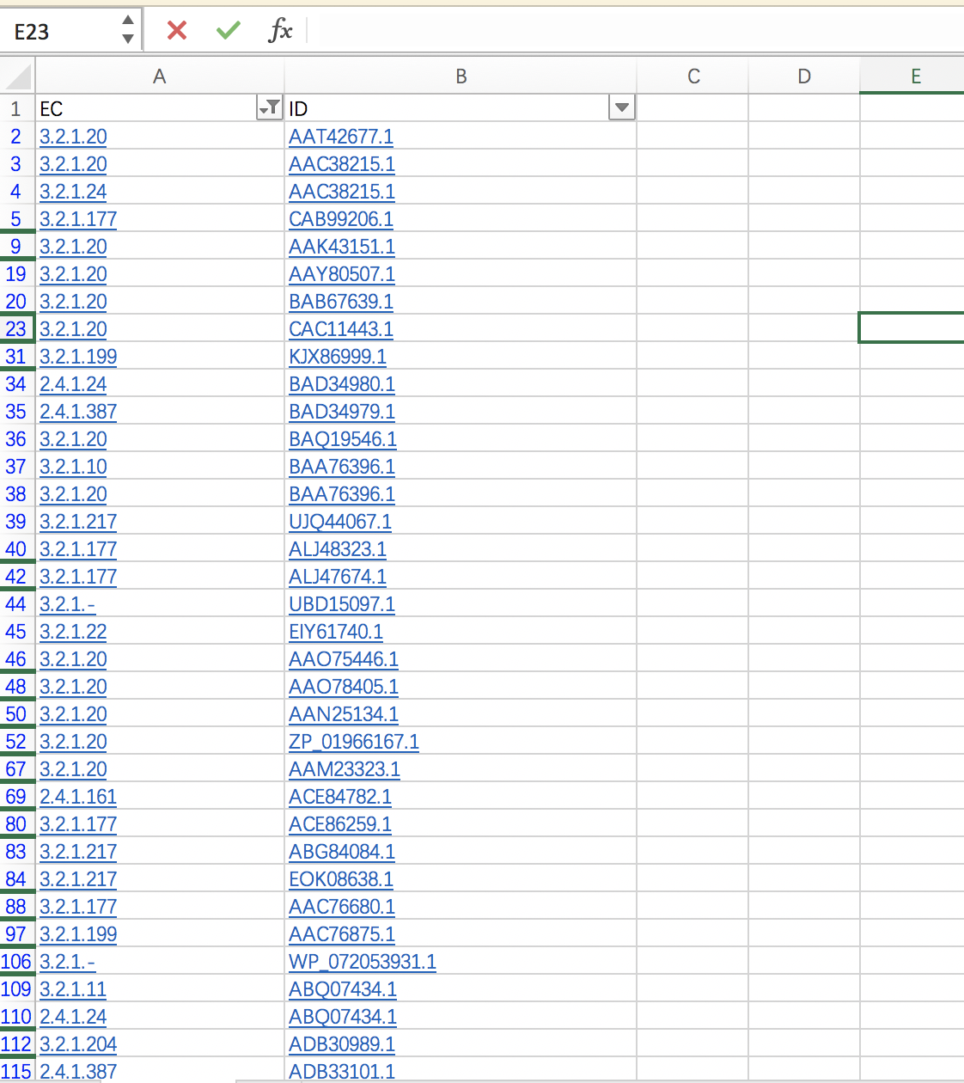
Go to the CAZy family page to get all characterized IDs.
Tabular column page will be shown.
Copy the Characterized IDs, EC numbers from the page and paste them in Excel and select only the IDs which only have hyperlinks (Characterized by CAZy) and make a list.
Copy those in the excel and revise it then use nano to make a txt file:
*There are some Genbank ID with multiple ECs, don’t forget to check, and keep all.

Slide 17
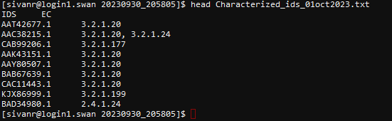
Finally get this result:
Name is “Characterized_ids_01oct2023.txt” (name could be changed but you also need to fix the program later).
The first row is IDS/EC

Slide 18
Part IV Sequence similarity networks (SSNpipe)
Create your part4 folder

Slide 19
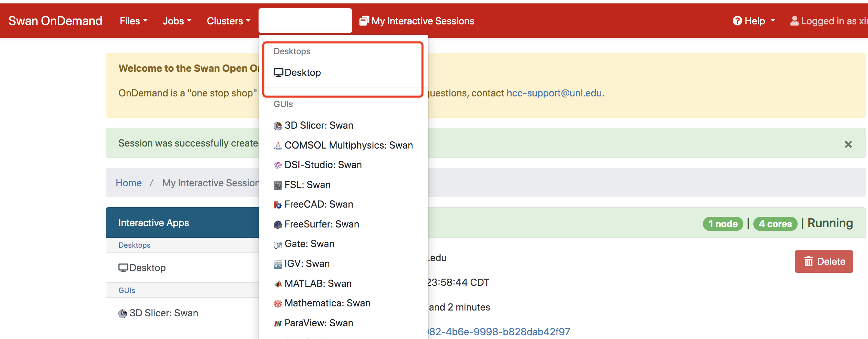
Create the part4 folder and use wget to download :
wget https://github.com/ahvdk/SSNpipe/releases/download/v.1.0-beta/ssnpipe_unix.tar.gz
tar –xvf ssnpipe_unix.tar.gz
Go to ondemand and click the “Interactive Apps”.
Set as the next slide.

Slide 20
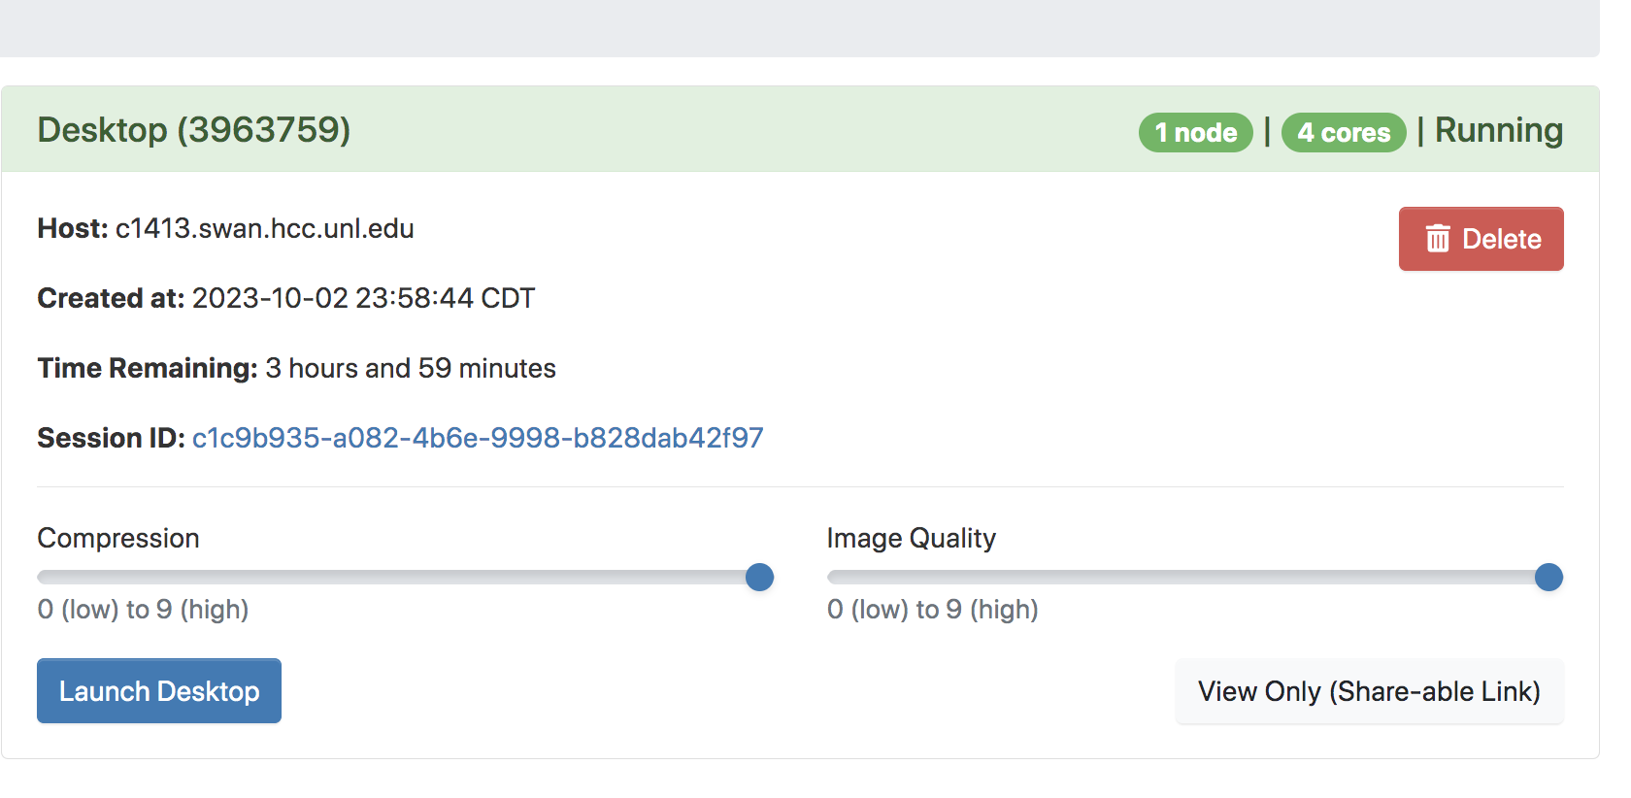
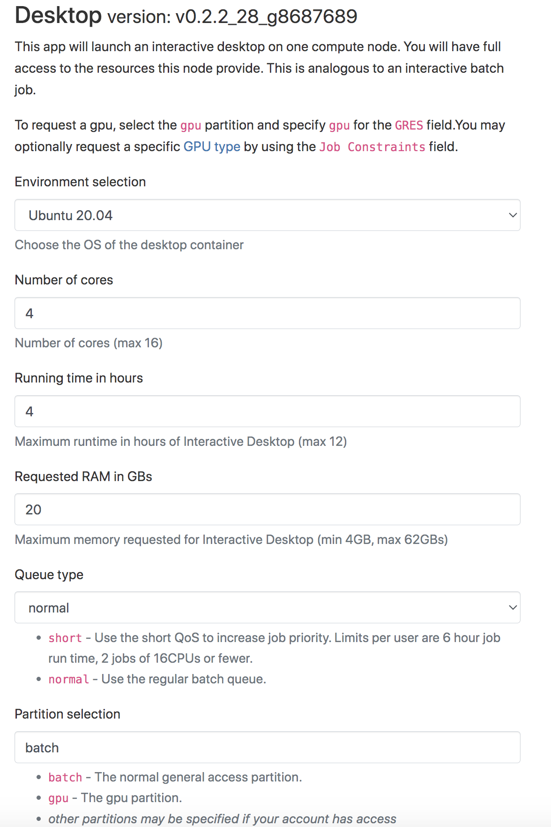


Slide 21
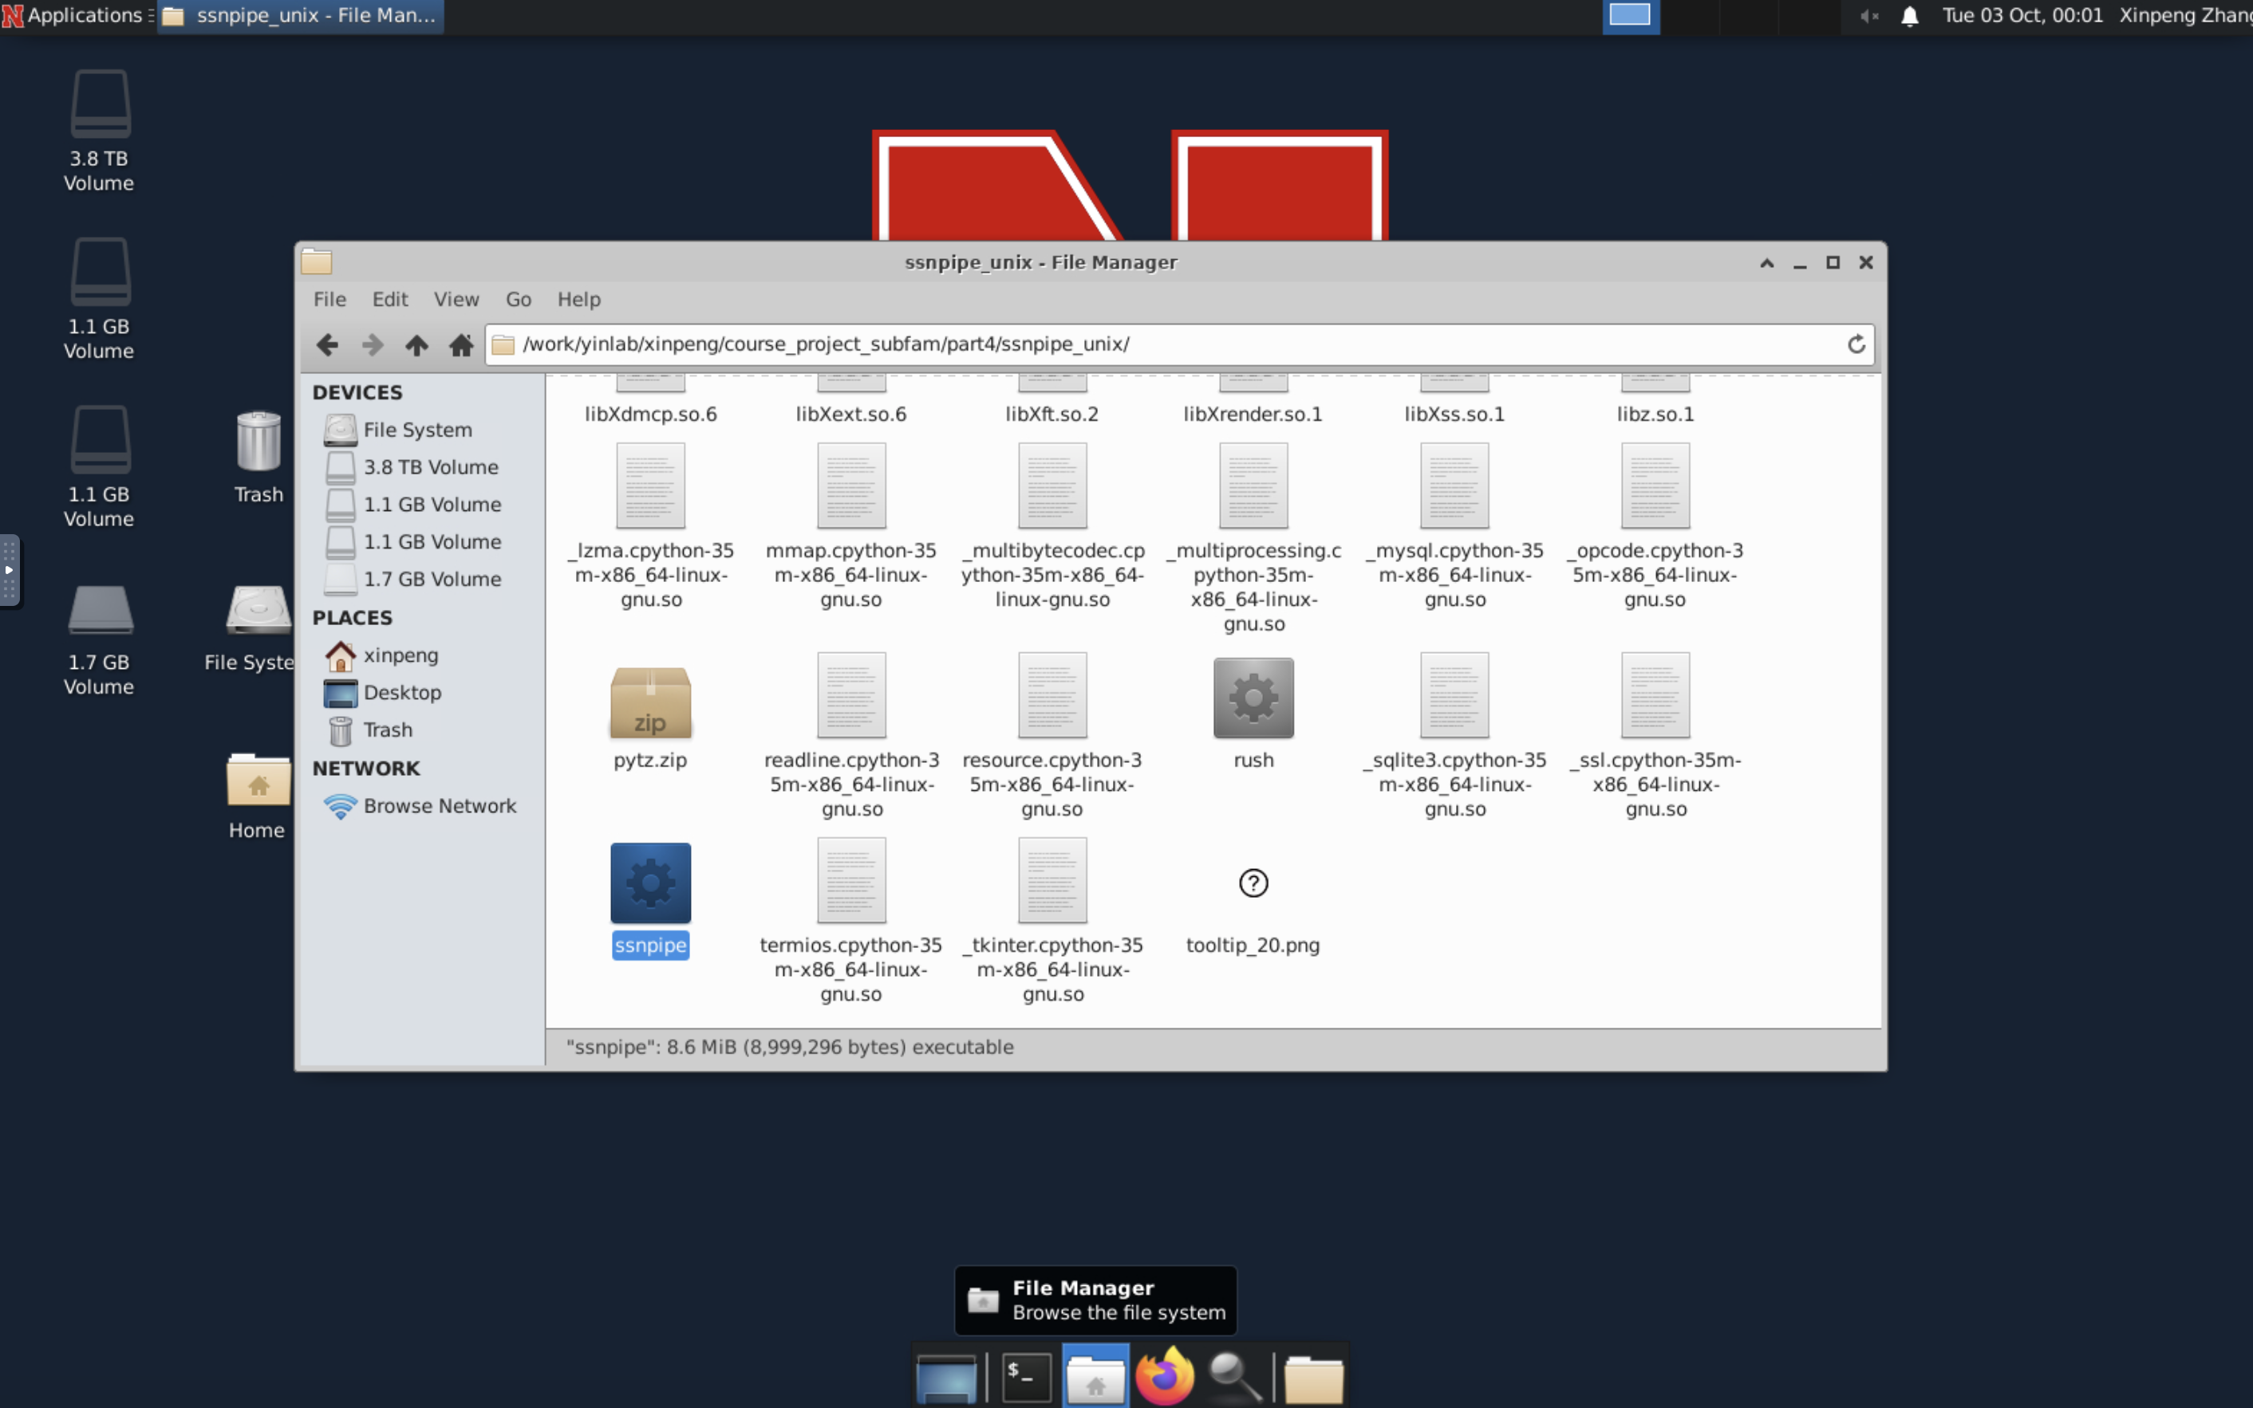
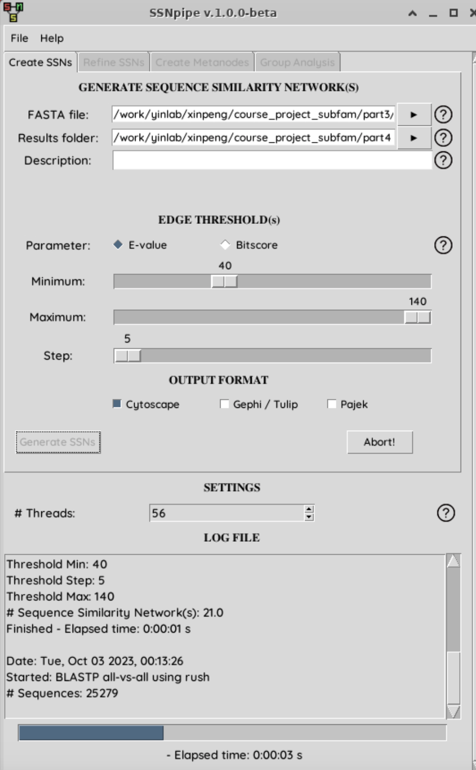
Click the file manager and change the path into part4 (Don’t use copy paste here).
Move to the ssnpipe folder.
Click the SSNpipe (GUI tool).
The FASTA file will use the extracted_domains.faa, and choose part4 folder as the results folder.
Click on Generate SSNs, the program will run for a few hours depending on the database size and computational power.
It takes me ~2hrs (1h47min).
NOTICE: Use only one step(Max=Min) for the project. Select based on your family. GH31 uses optimized subfamily clusters at E-value of 1E-115.

Slide 22
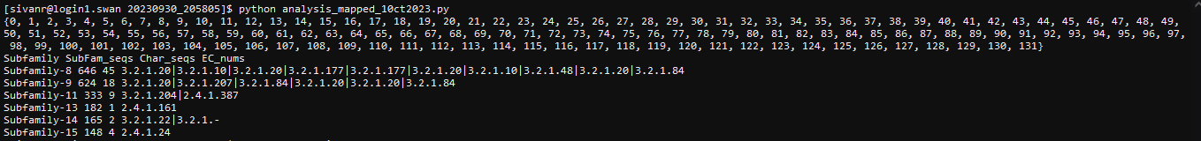
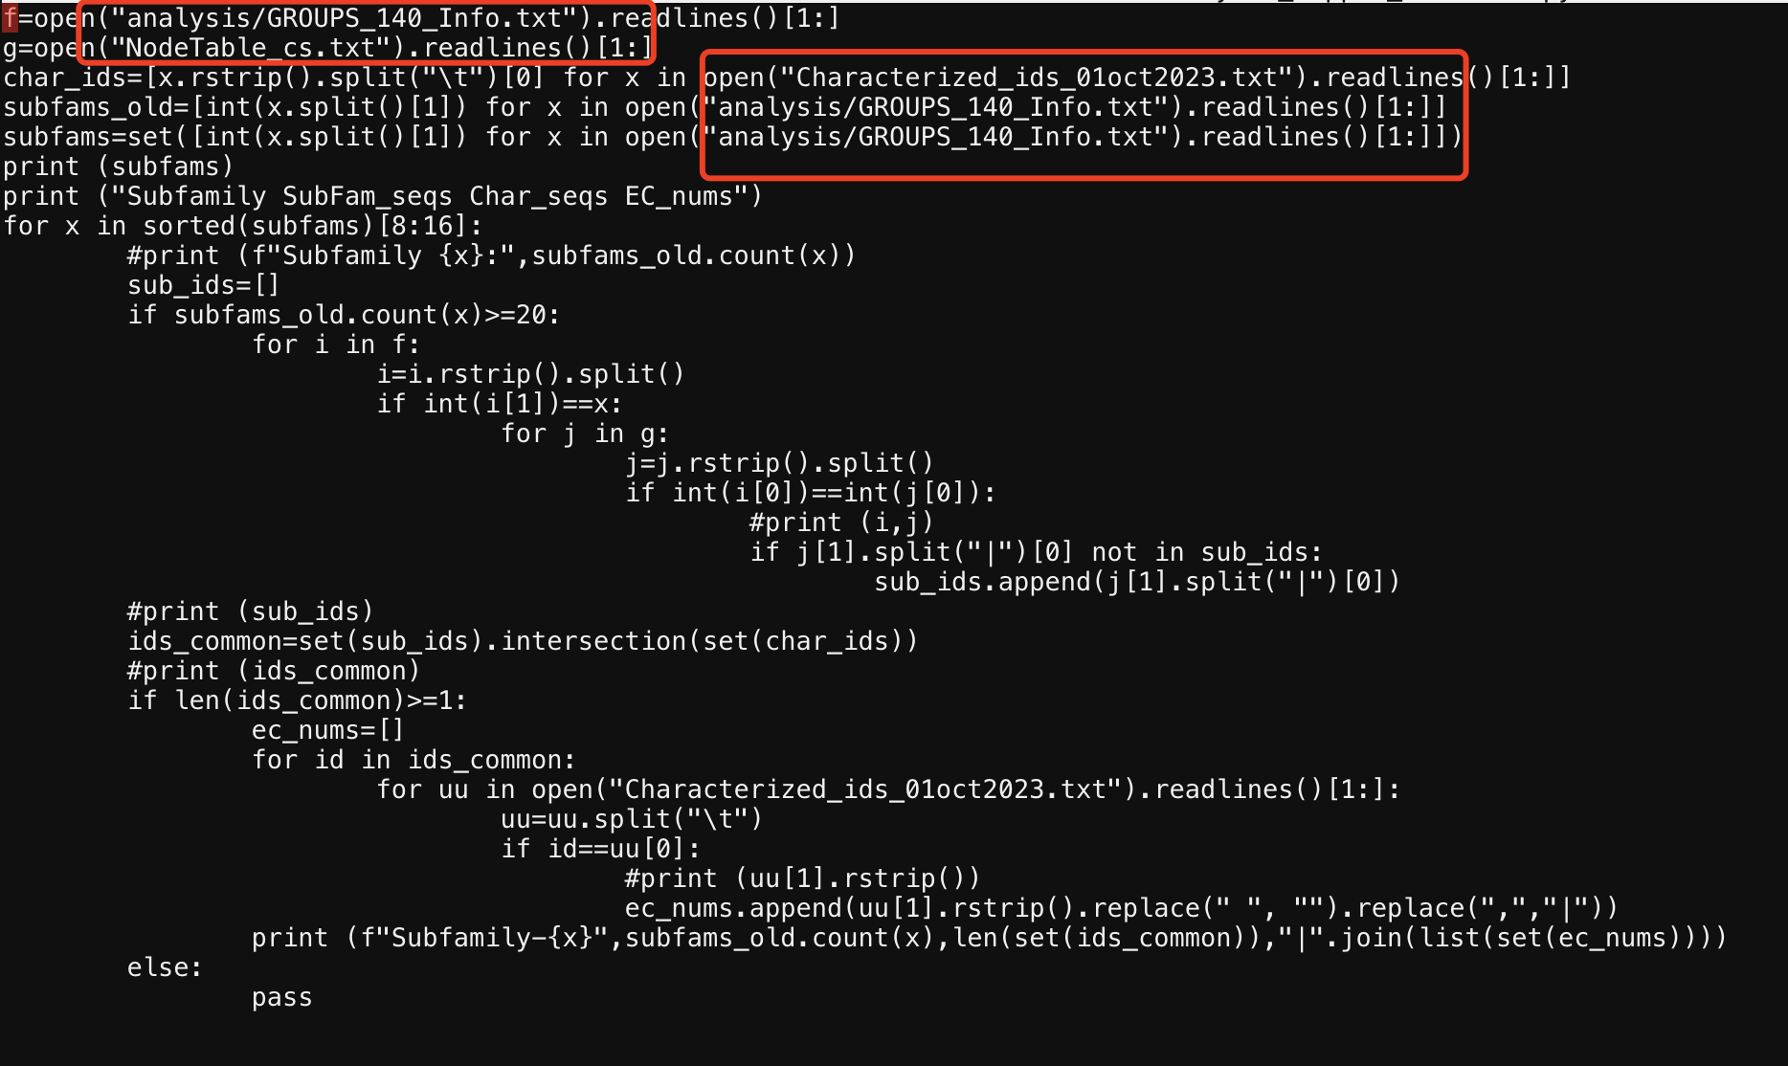
Depending on the network files size you may need to create a metanodes (3rd tab in the SSNpipe interface)
Generate Group Analysis files from the 4th tab.
Results can be processed with the following python program (given) and EC-Numbers can be mapped.
cp ../Class_project/analysis_mapped_1oct2023.py your_result_folder
(the SSNPipe will create a result folder with data and time)
cp ../part3/Characterized_ids_01oct2023.txt your_result_folder
python analysis_mapped_1oct2023.py
( or you need to revise this program if you use different characterized id file name).
You could revise those names (from SSNpipe).

Slide 23
Part V Cytoscape Visualization
Do not need an extra folder

Slide 24
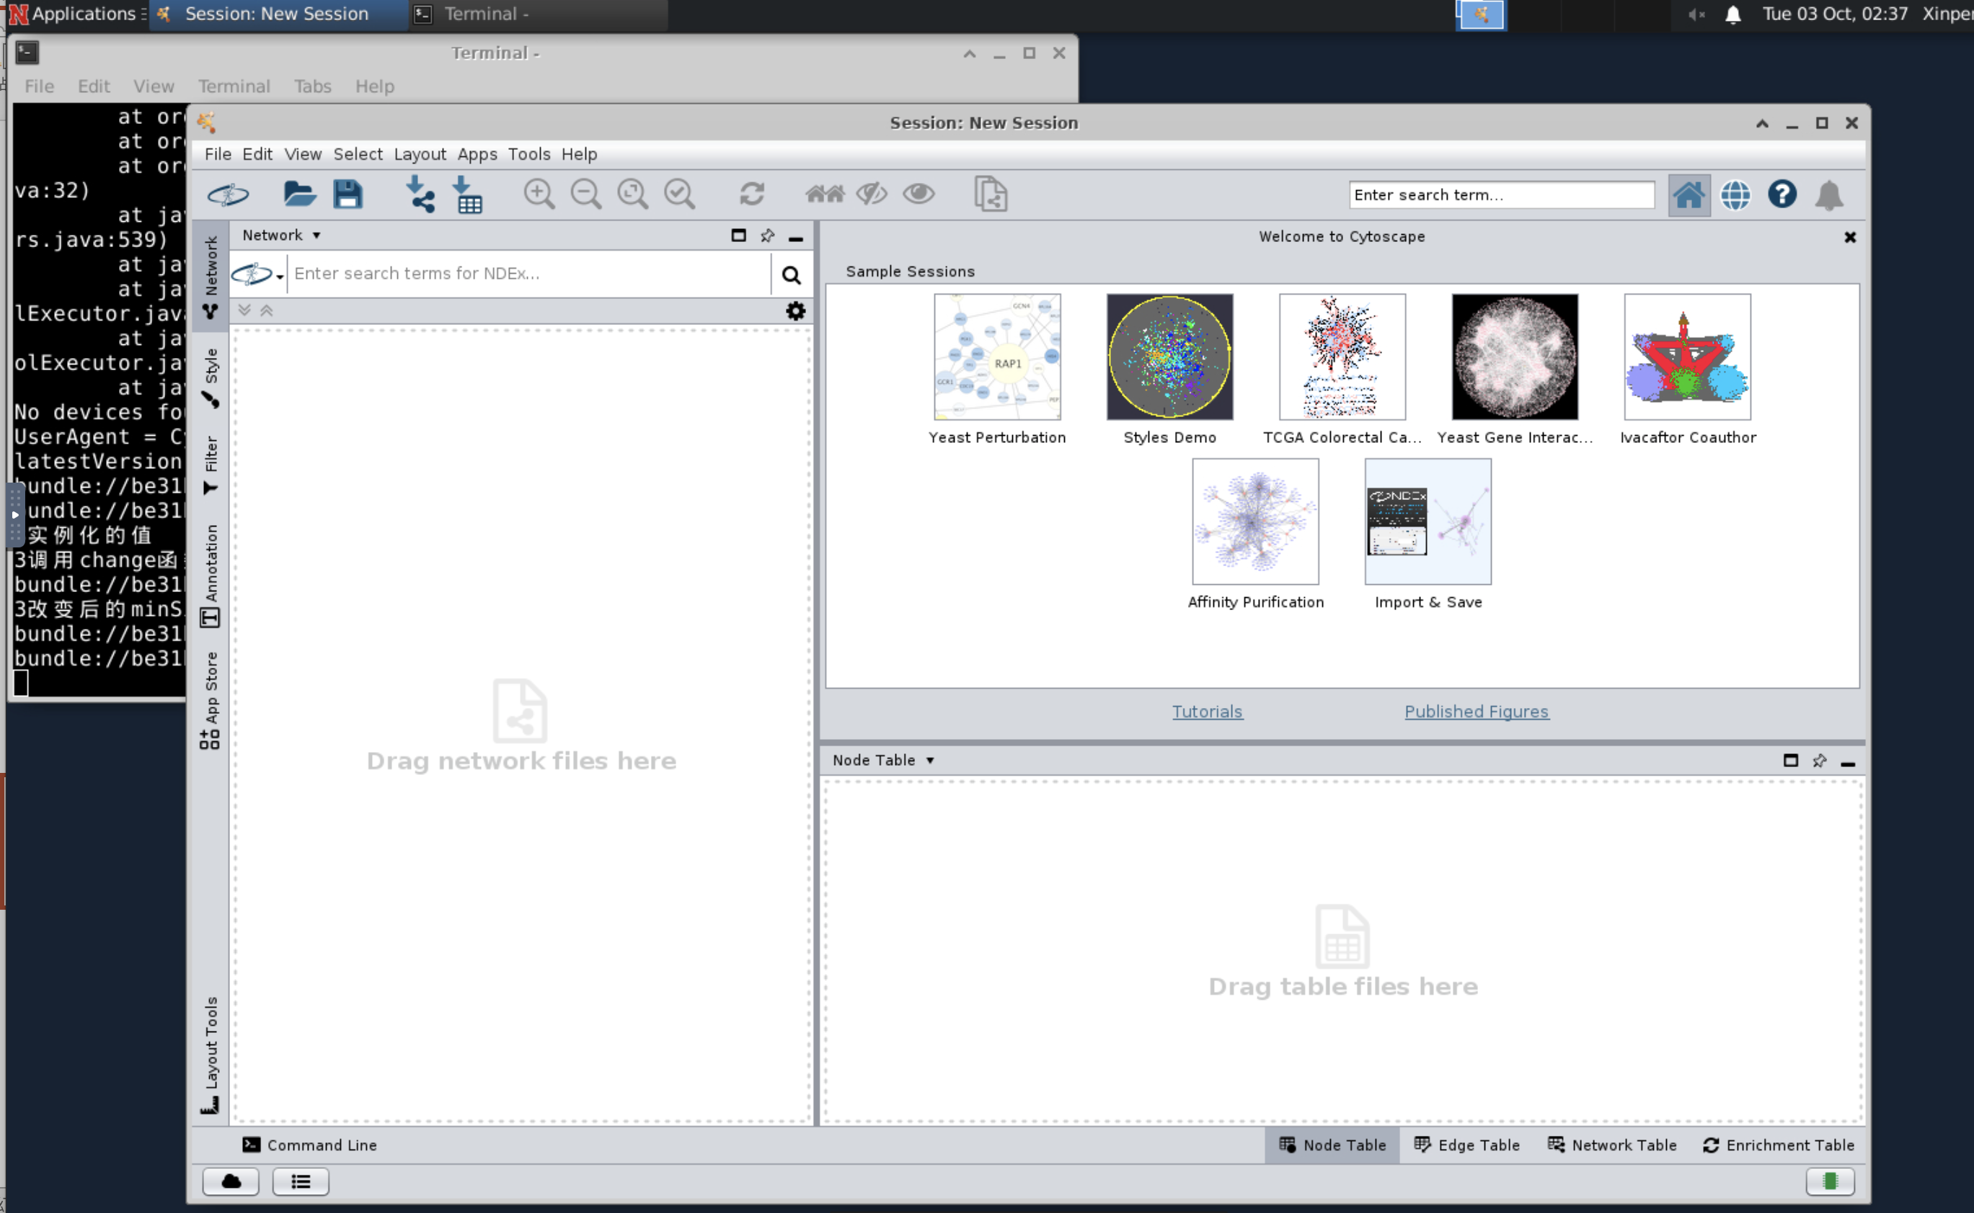
We continue using the desktop but click the terminal on the left of “File manager”
Type :
ml cytoscape/3.10
cytoscape.sh
Click the red circle to import network we made in part4.
Network will be loaded.
Use a yFiles Organic layout from the layout panel. (Install if not available)

Slide 25
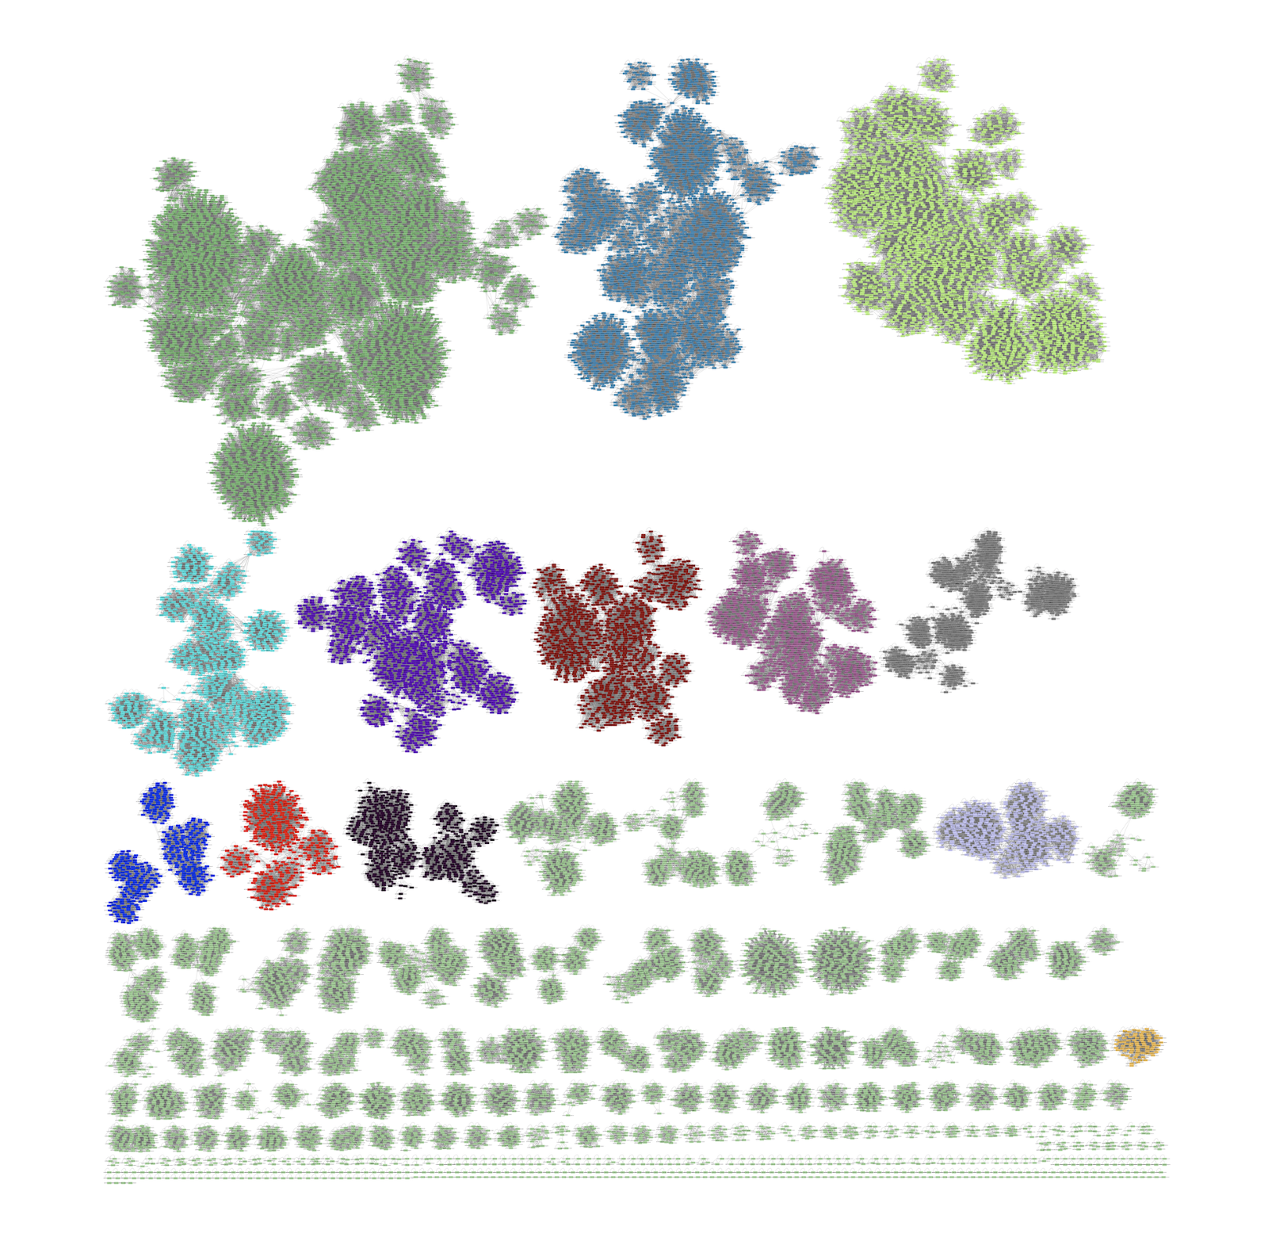
You may notice a change in a layout after the Algorithm is selected.
Check different nodes (proteins) and subfamilies (clusters), how they are aligned, etc.
Group them based on the connected nodes and color them for easy visualization.
For example, I have used the network results obtained from the blast results with the cutoff of E-value 1e-140 and their sequence similarity networks (SSN) “NETWORK_cs_ev_140_.txt”
Modified colors based on the connected nodes and subfamilies. (This can be done by selecting the connected nodes in each cluster).
Google it to know how to make it pretty.

Slide 26
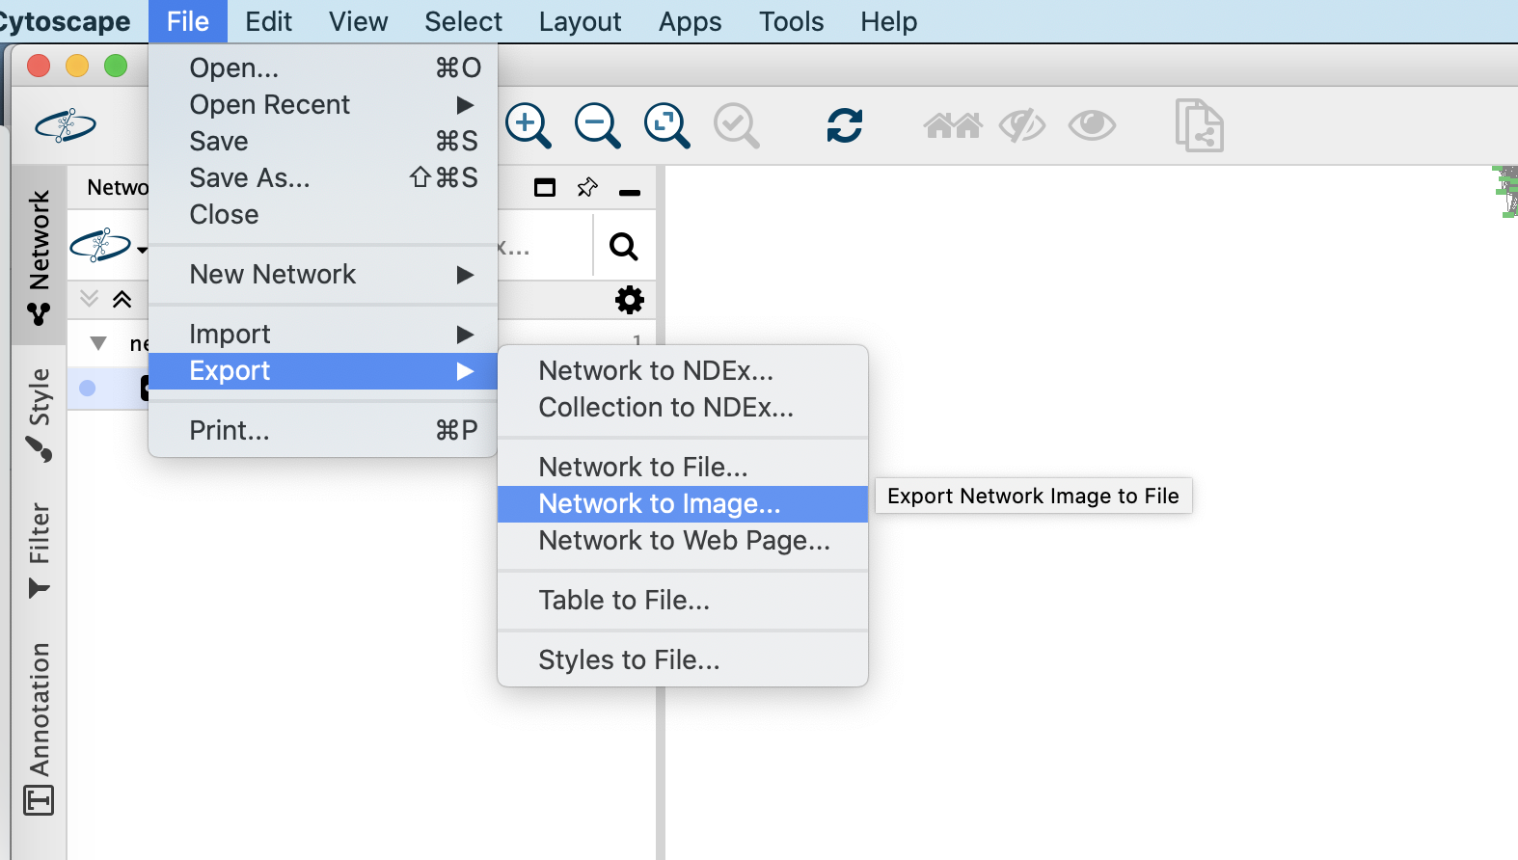
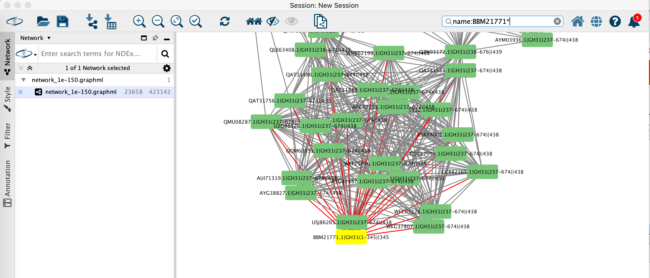
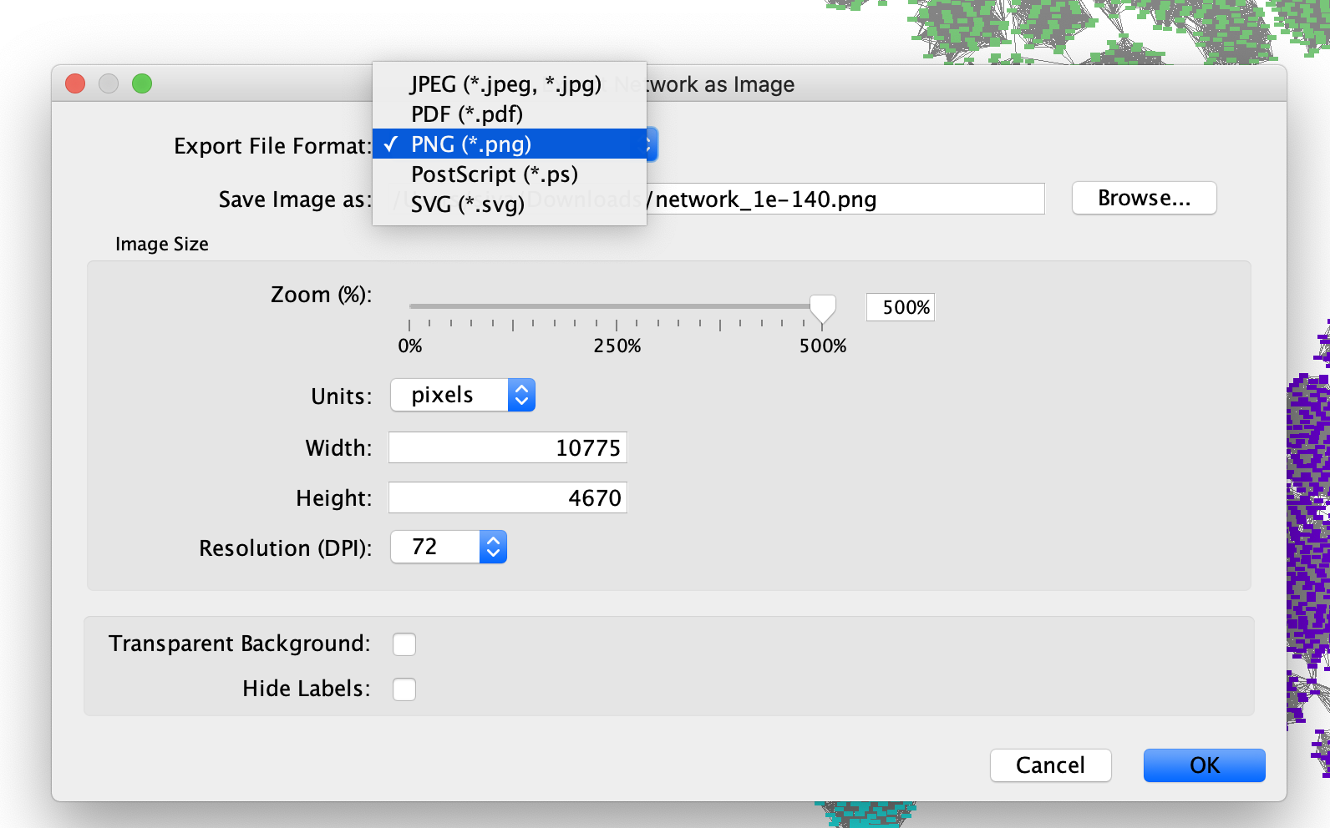
Export the network to an Image or PDF
Searching the Characterized IDs in a network
Use the top right search box in the Cytoscape to find out the characterized to mark them differently.
Search format: name:YL*
Example search: name:BBM21771.1*
Export the network to an Image or PDF
Here, we have selected the query "BBM21771" This query has 1 node and 25 edges. All are highlighted here, which can be colored seperatly using the Style on the left panel.

Slide 27
Part VI Phylogenentic Analysis
Create your part6 folder

Slide 28
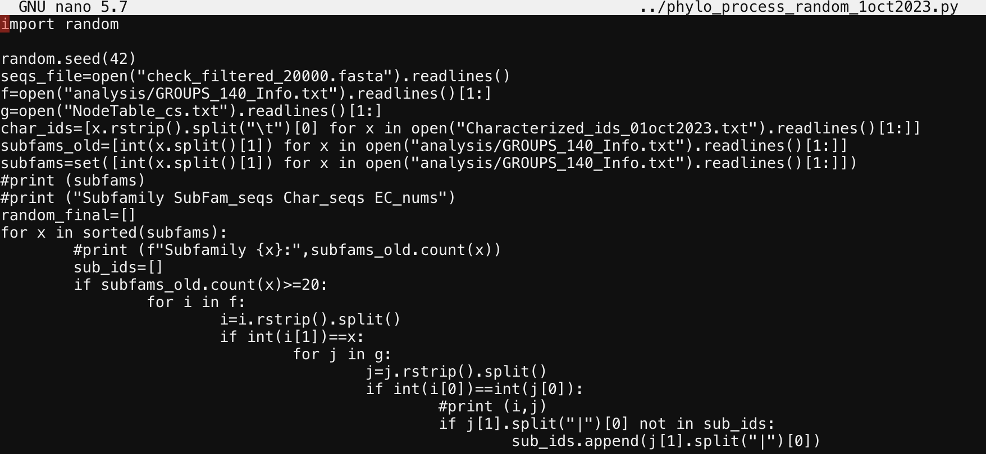
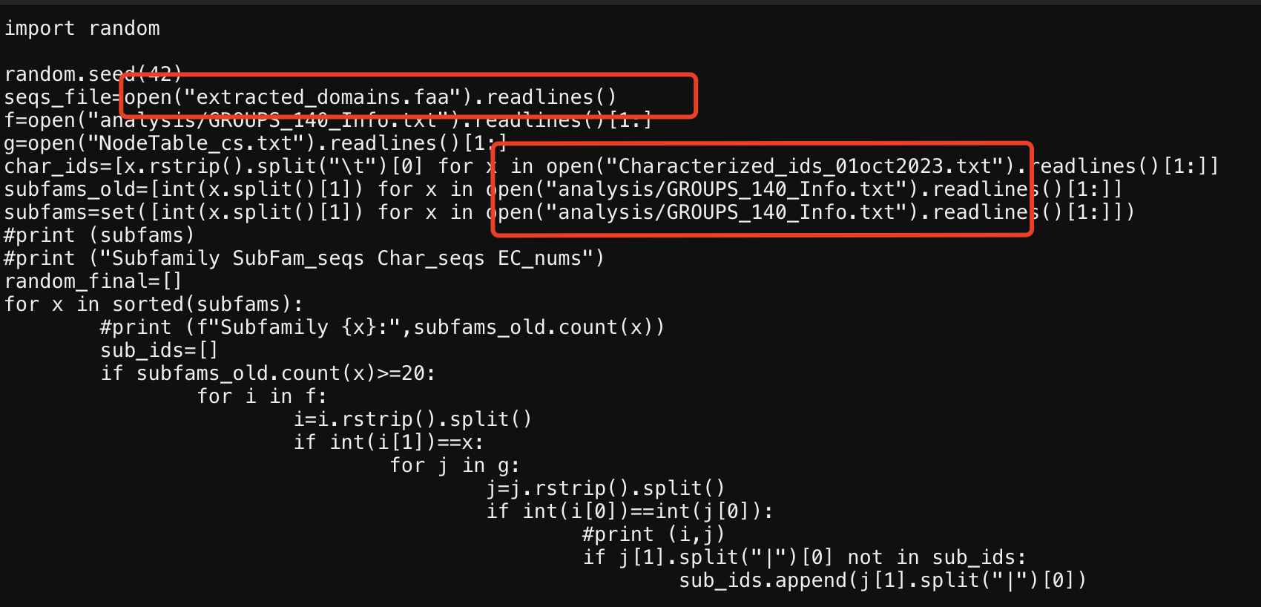
Evaluate how well the SSN clusters (subfamilies) match phylogenetic classification.
Use a python program to select random 30 sequences from each subfam and use them for phylogeny buliding using FastTree.
cp ../Class_project/phylo_process_random_1oct2023.py .
python phylo_process_random_1oct2023.py > phylo_input_fasttree_140.fasta
It takes around 10 mins.
Check what are needed for the python program and cp folders/files into the current folder (you need extracted domain faa from part3, analysis/GROUPS_140_Info.txt from part4, Characterized_ids_01oct2023.txt from part3).

Slide 29
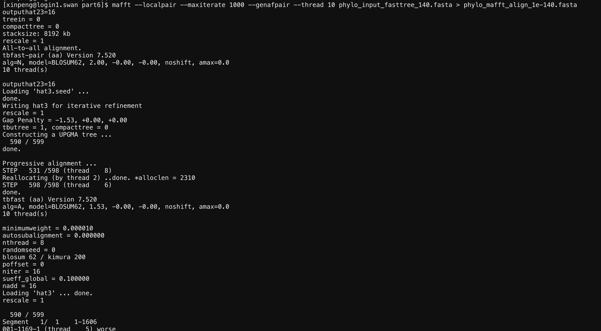
HCC module load MAFFT
srun --nodes=1 --ntasks-per-node=10 --mem-per-cpu=1024 --pty $SHELL
(use interactive node, srun to avoid the job being killed)
ml mafft/7.520
mafft --localpair --maxiterate 1000 --genafpair --thread 10 phylo_input_fasttree_140.fasta > phylo_mafft_align_1e-140.fasta
Or use slurm in the next slides.
It takes me ~ 1hr to finish

Slide 30
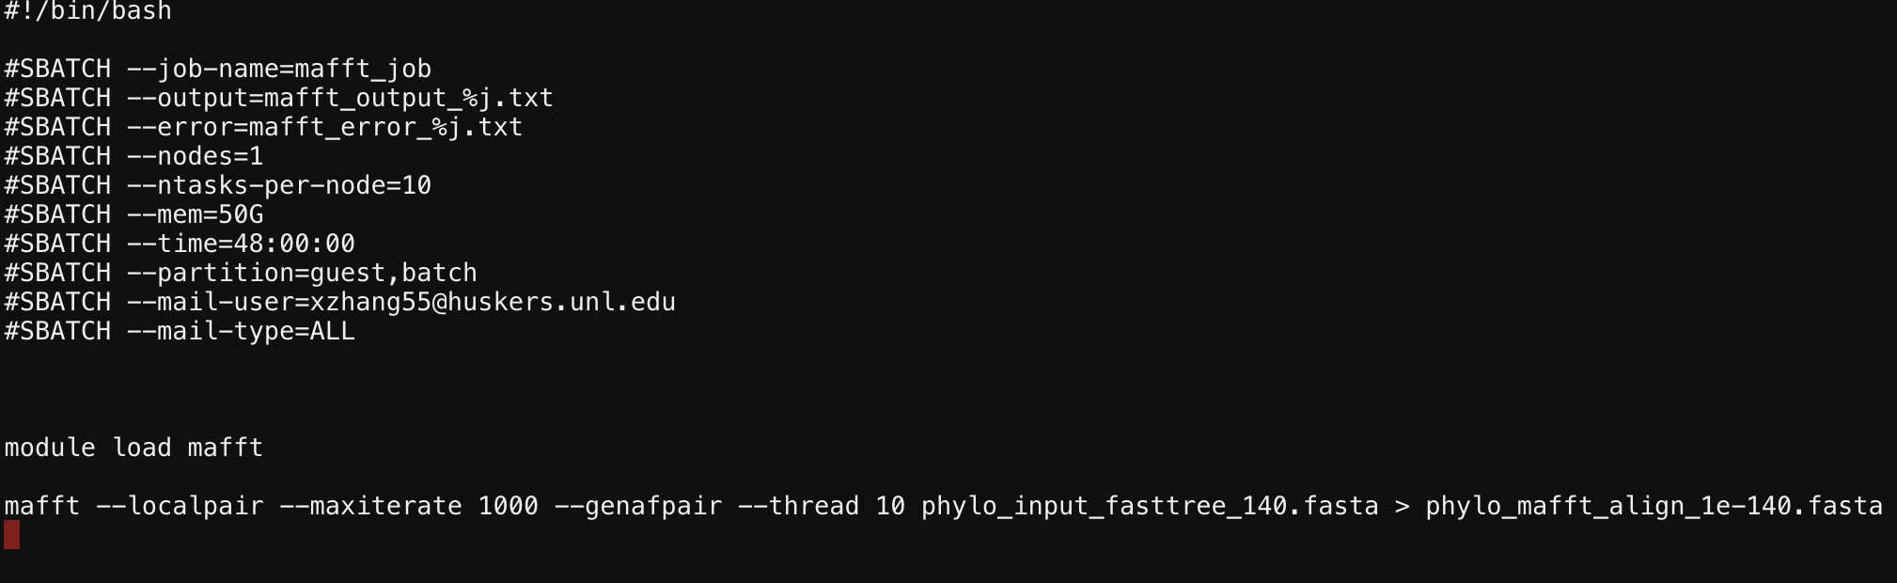
#!/bin/bash
#SBATCH --job-name=mafft_job
#SBATCH --output=mafft_output_%j.txt
#SBATCH --error=mafft_error_%j.txt
#SBATCH --nodes=1
#SBATCH --ntasks-per-node=10
#SBATCH --mem=50G
#SBATCH --time=48:00:00
#SBATCH --partition=guest,batch
#SBATCH --mail-user=xzhang55@huskers.unl.edu
#SBATCH --mail-type=ALL
module load mafft
mafft --localpair --maxiterate 1000 --genafpair --thread 10 phylo_input_fasttree_140.fasta > phylo_mafft_align_1e-140.fasta

Slide 31
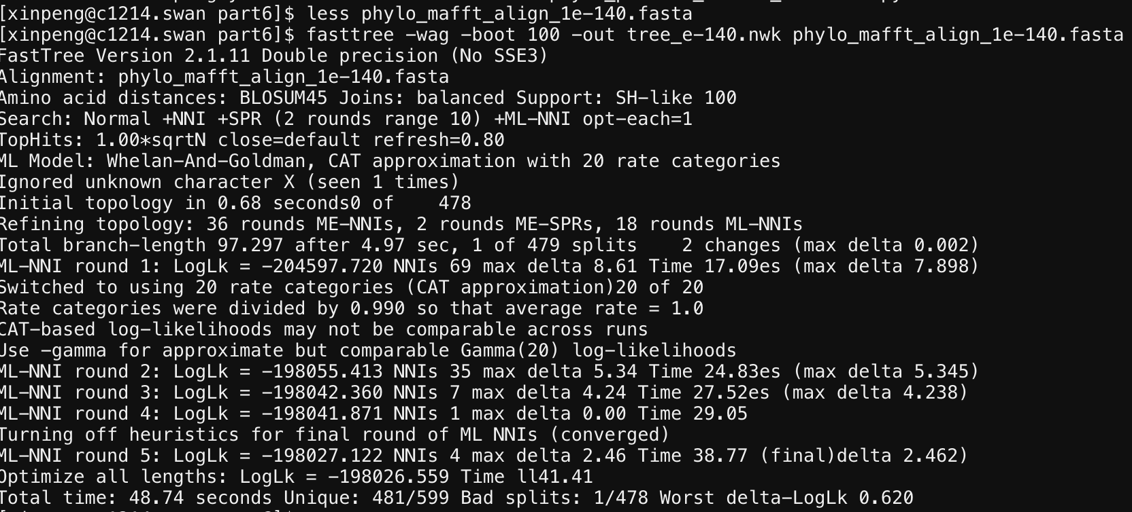
HCC module load FASTTREE
ml fasttree/2.1
fasttree -wag -boot 100 -out tree_e-140.nwk phylo_mafft_align_1e-140.fasta

Slide 32
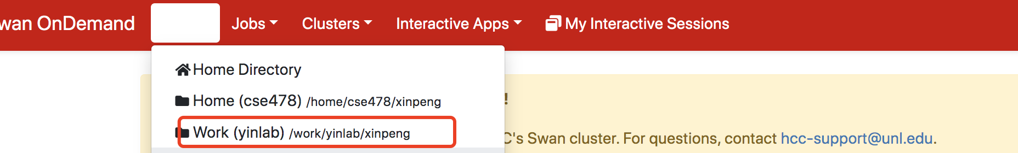
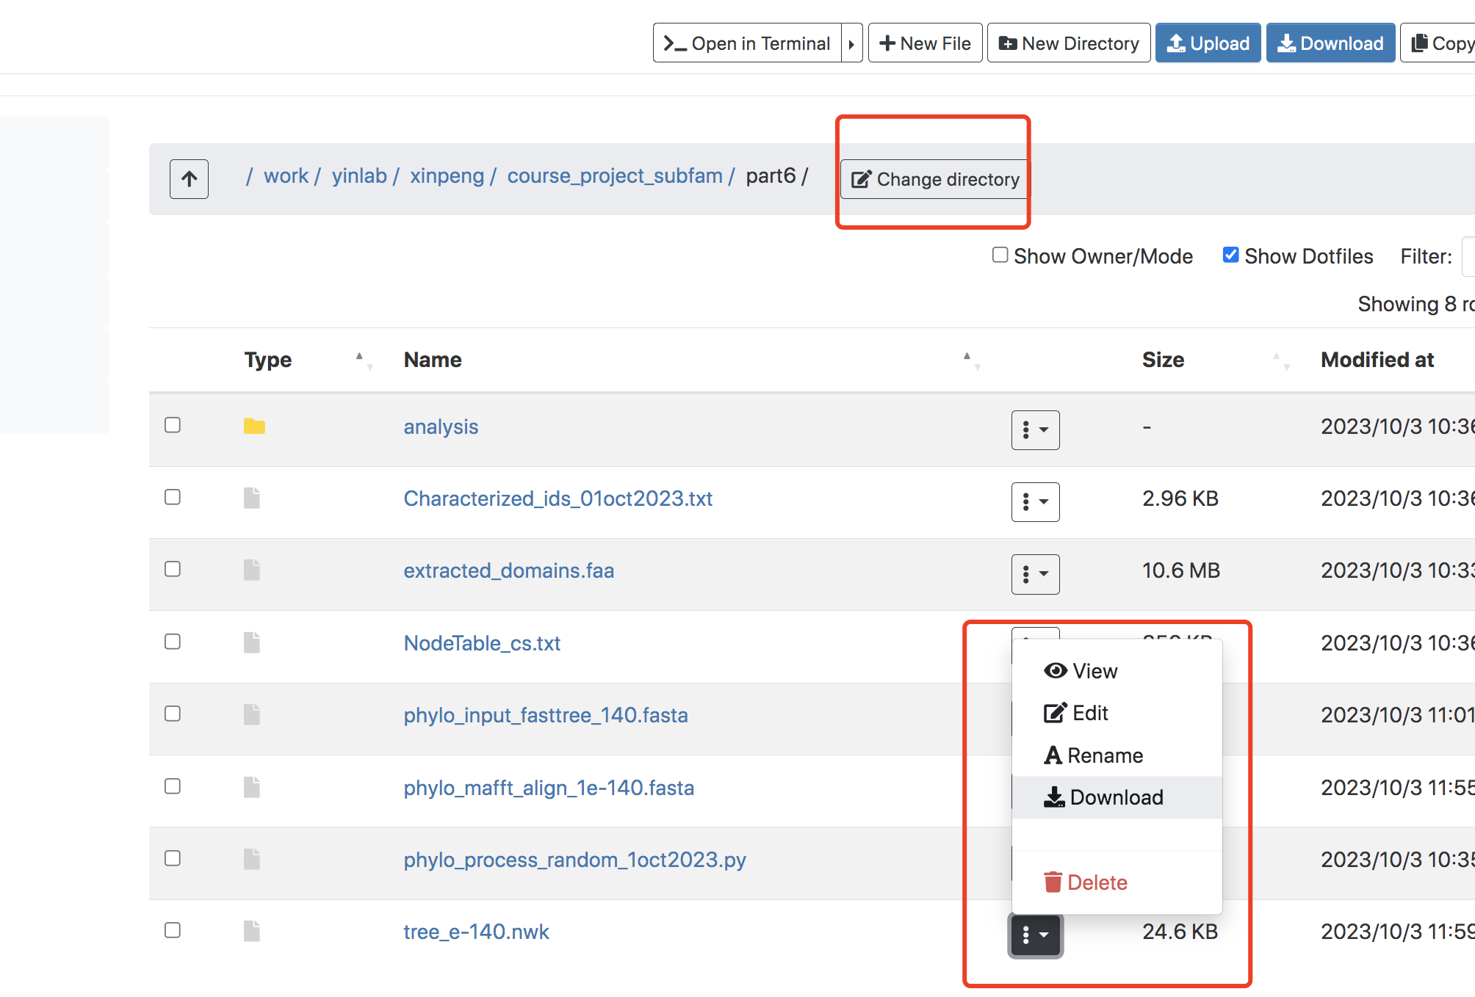
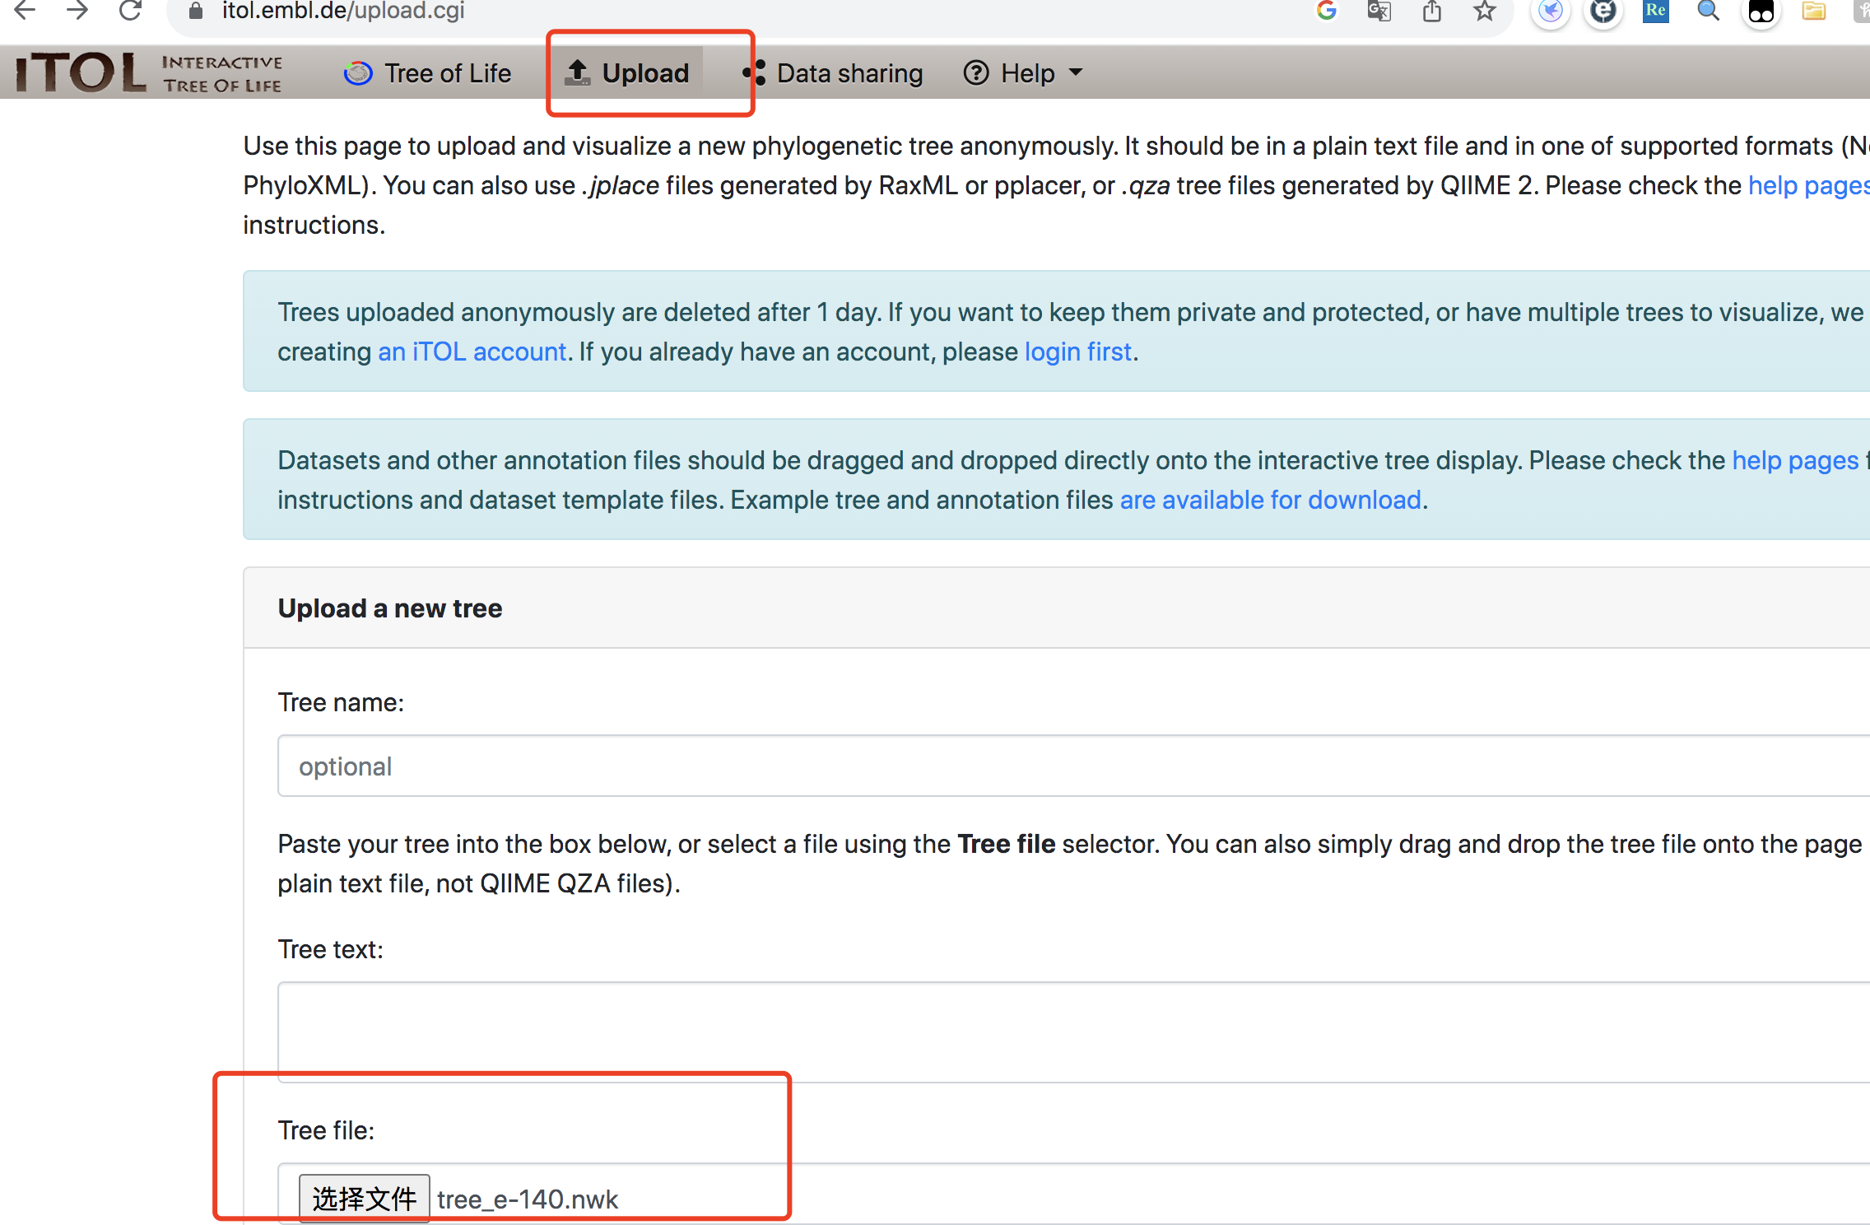
“tree_e-140.nwk” can be visualized using the iTOL available online. https://itol.embl.de/
Download the nwk file to your laptop
Example for the SSN 1E-140 build tree

Slide 33
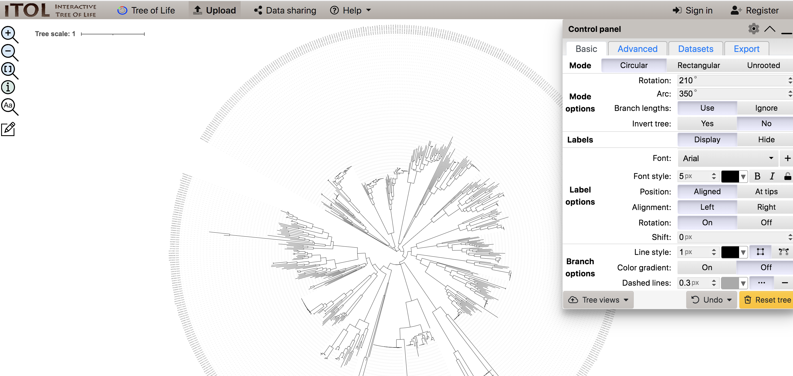
“tree_e-140.nwk” can be visualized using the iTOL available online. https://itol.embl.de/
Explore the options over the webserver and save the image for the best SSN Evalue.

Slide 34
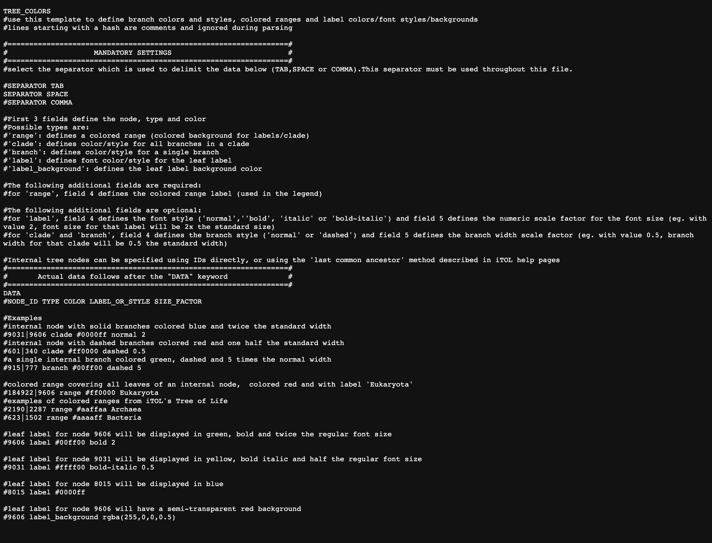
Create color definition files to highlight those nodes(protein) with subfamily.
In ITOL, there are multiple functions to revise the tree.
https://itol.embl.de/help.cgi#functions
We will use “COLOR RANGE” function to label subfamilies in the tree.
https://itol.embl.de/help/colors_styles_template.txt

Slide 35
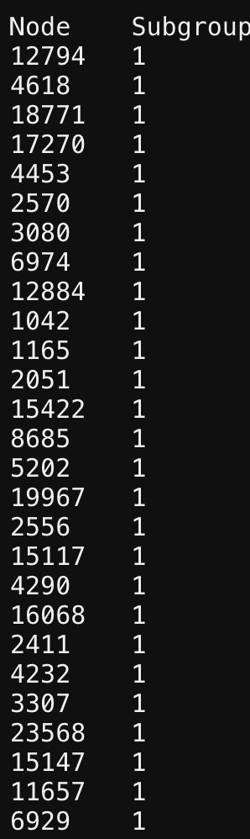
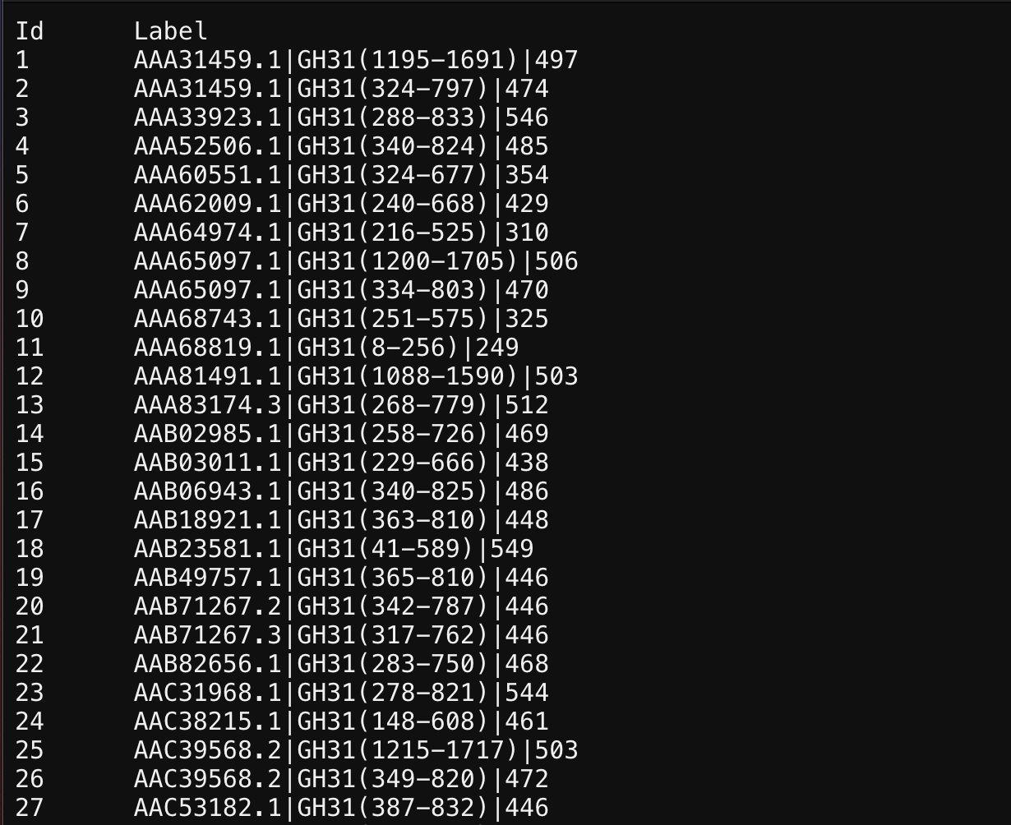
To create the DATASET file:
We have some results from part4:
We need to combine these two file.
We need to extract the IDs we used in the tree (because we use random protein sequences from part5 to make the tree).
We also need to follow
the template format.
GROUPS_140_Info.txt(you may have different name based on your part4-Group Analysis, containing Node ID and subfamily ID).
NodeTable_cs.txt (containing Node ID and protein ID)
grep ">" phylo_mafft_align_1e-140.fasta | cut -f1 -d'(' | sed 's/>//' >list
python itol_color_strip.py GROUPS_140_Info.txt NodeTable_cs.txt output.txt --id_file list
cat Characterized_ids_01oct2023.txt | awk -v FS='\t' -v OFS='\t' '{print$1"|GH31",$2}’ > ec.id.txt
python ec.itol_color.py –input ec.id.txt --output itol_ec_color.txt

Slide 36
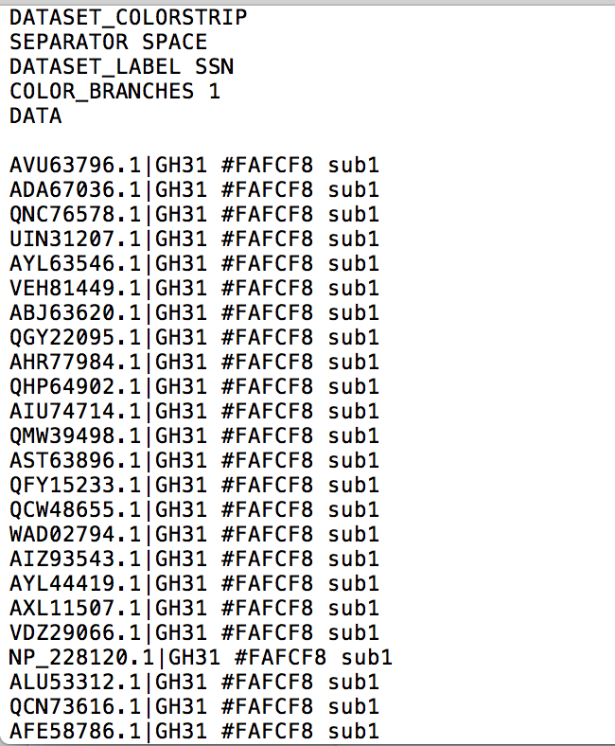
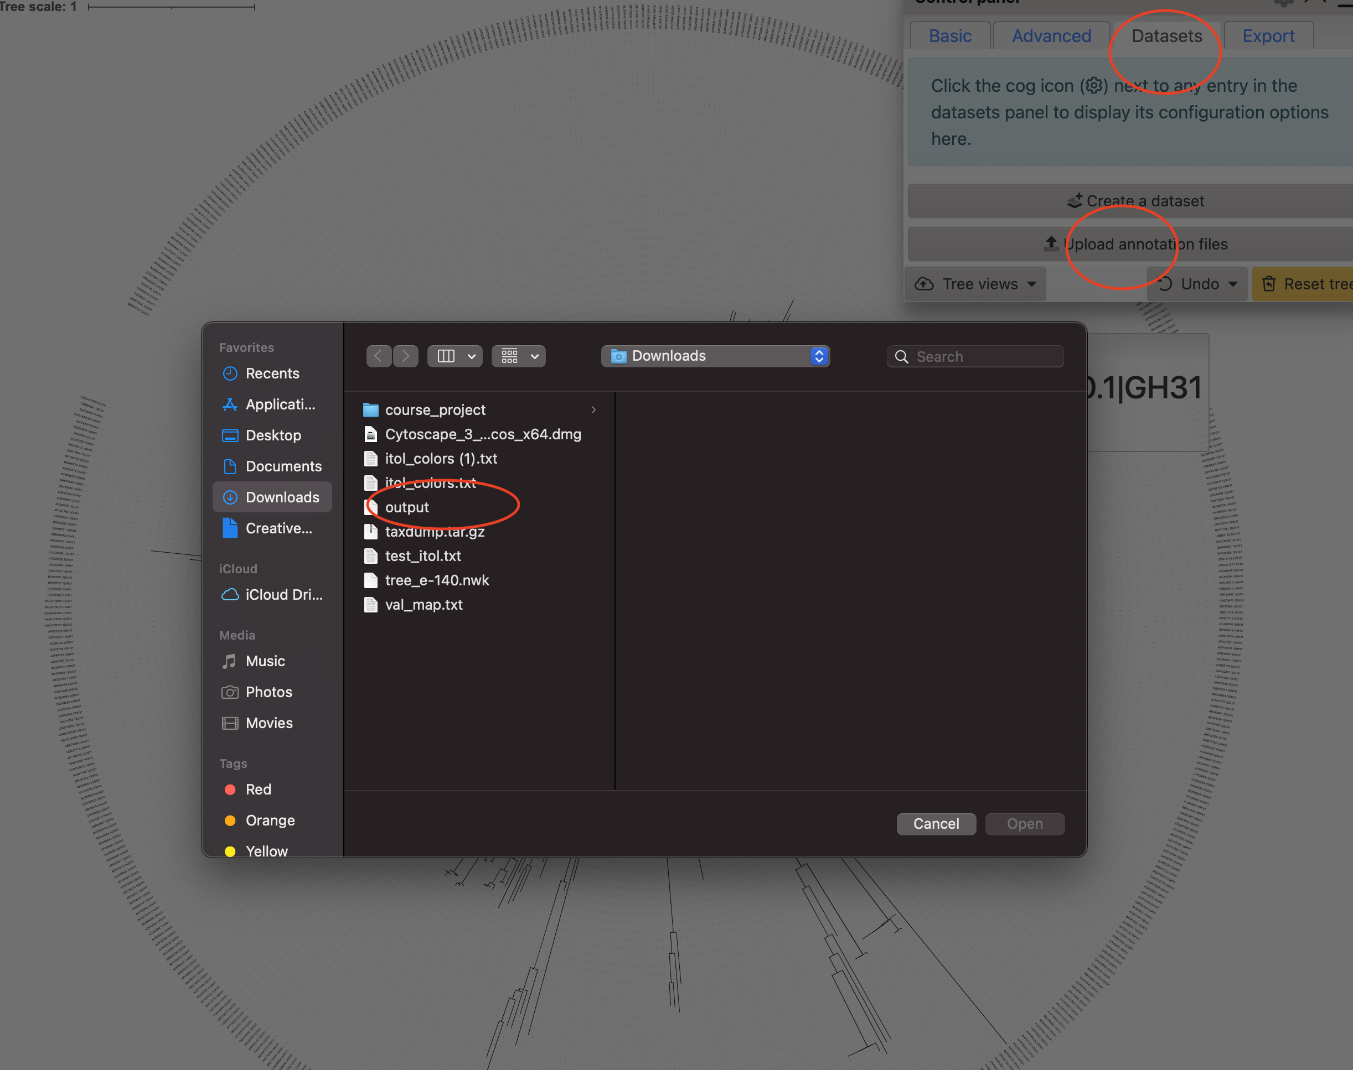
Download those (two outputs) on your laptop and import it into iTOL.

Slide 37
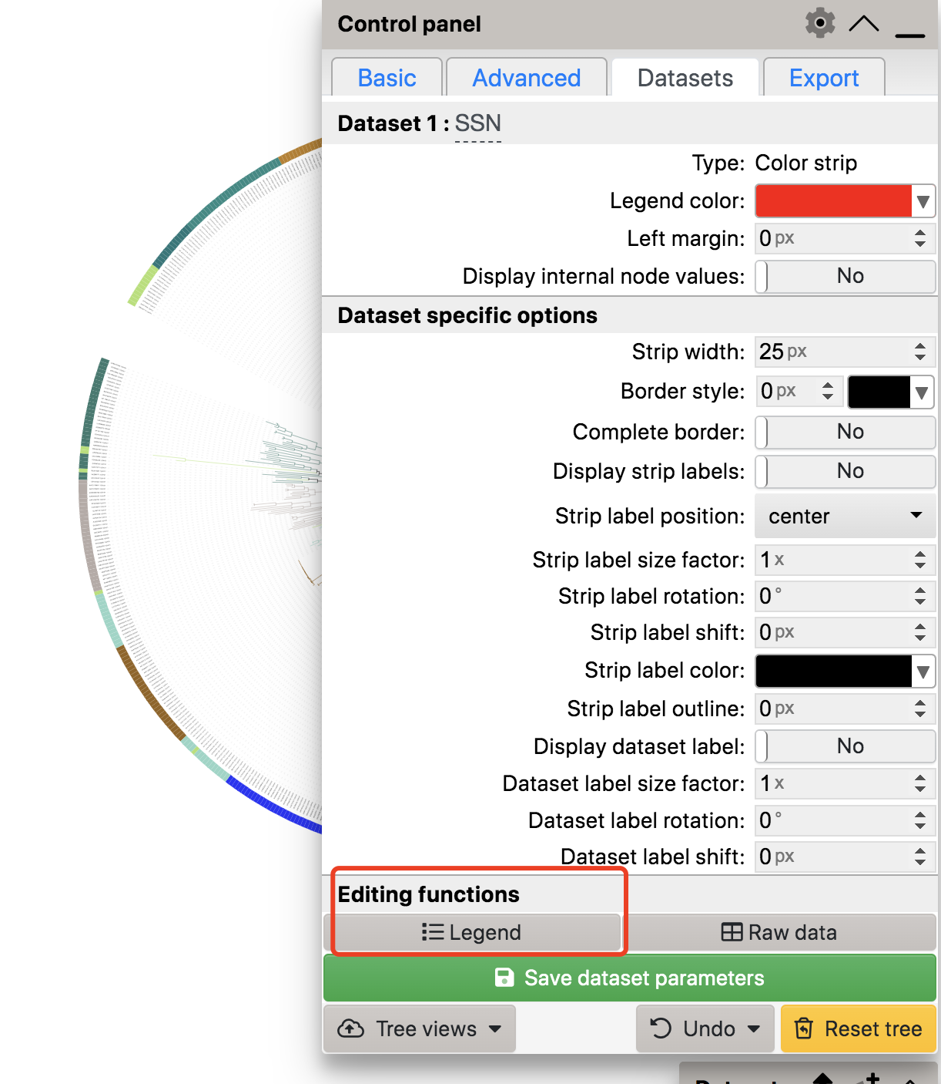
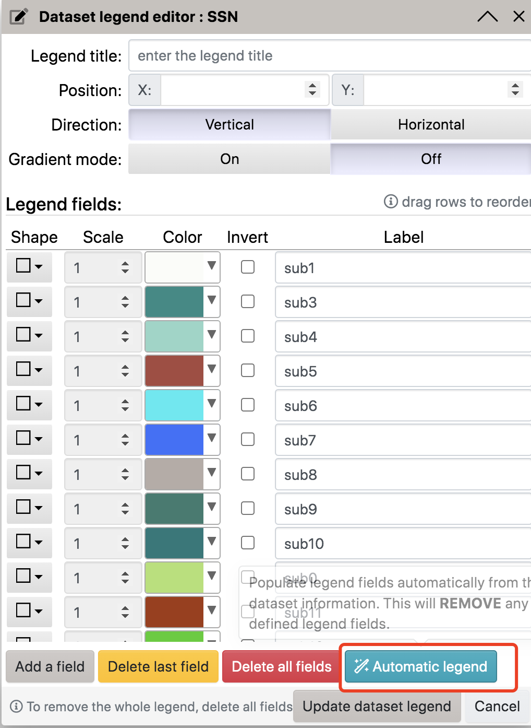
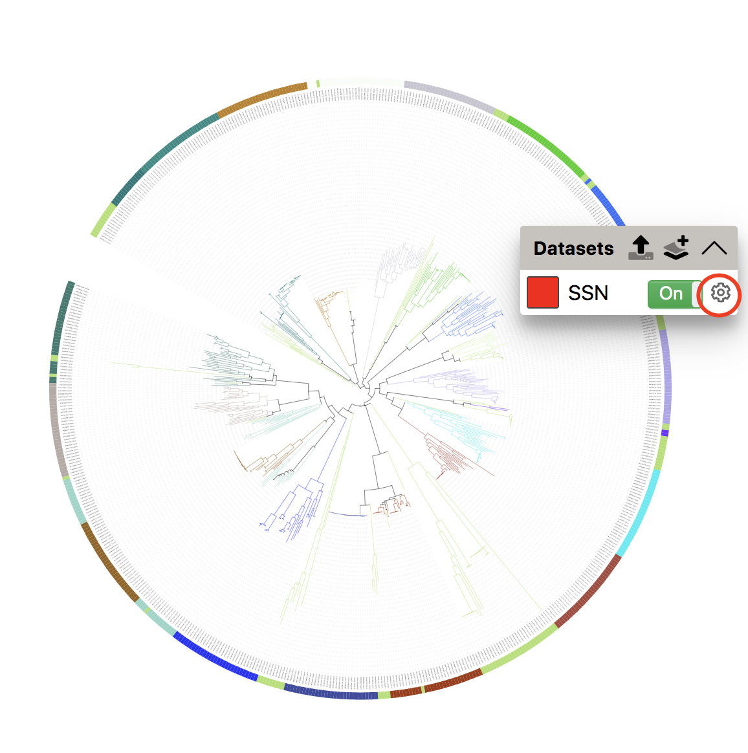
Follow the steps to get legends.
We have two ring: subfam and EC number.

Slide 38
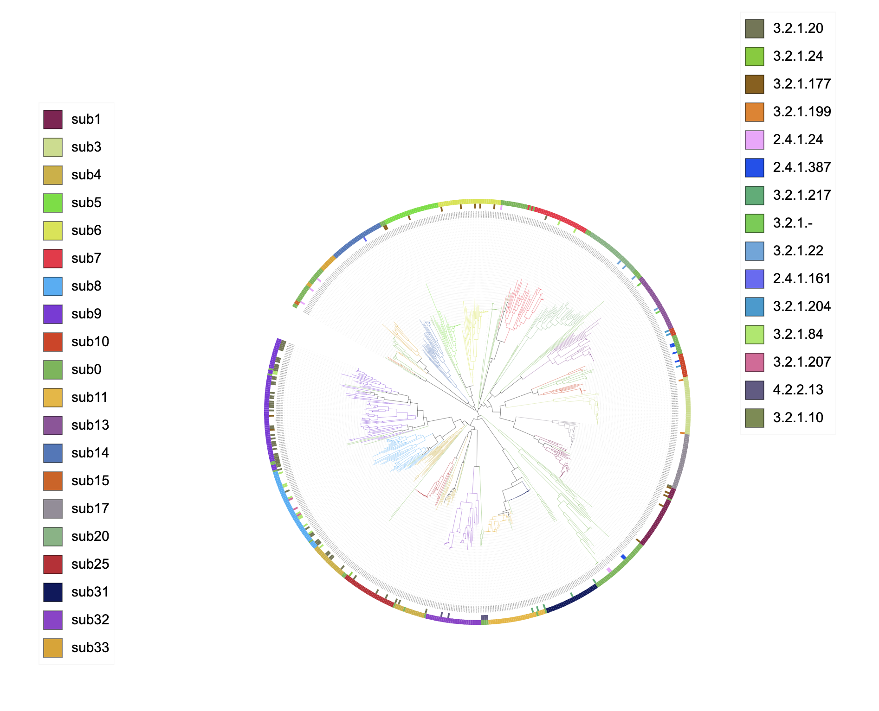
You could export the result as SVG/PNG file.
NOTICE:
If you don’t have a subscription account, the annotations would not be saved. Please export the result when you finish.
Sign up an account to keep the result (without annotations).

Slide 39
Part VII Other analysis
Create your part7 folder

Slide 40
Interpretation and analysis of the subfamilies based on the Phylogeny and subfamilies from the selected E-value.
Interpretation steps and protocol:
Explain each subfamily in terms of EC number, taxonomical diversity, enzyme activity and structures.
Select any one characterized ID and their EC numbers from each subfamily from the results (Output of “analysis_mapped_1oct2023.py”).
If PDB ID (Protein Data Bank, https://www.rcsb.org/) is available, take the structure, or else model them using “Swiss-model” or AlphaFold2.
Identify the common catalytic domain between each subfamily.
Use PyMol to load and visualize the structures. (Available in HCC interactive apps).

Slide 41
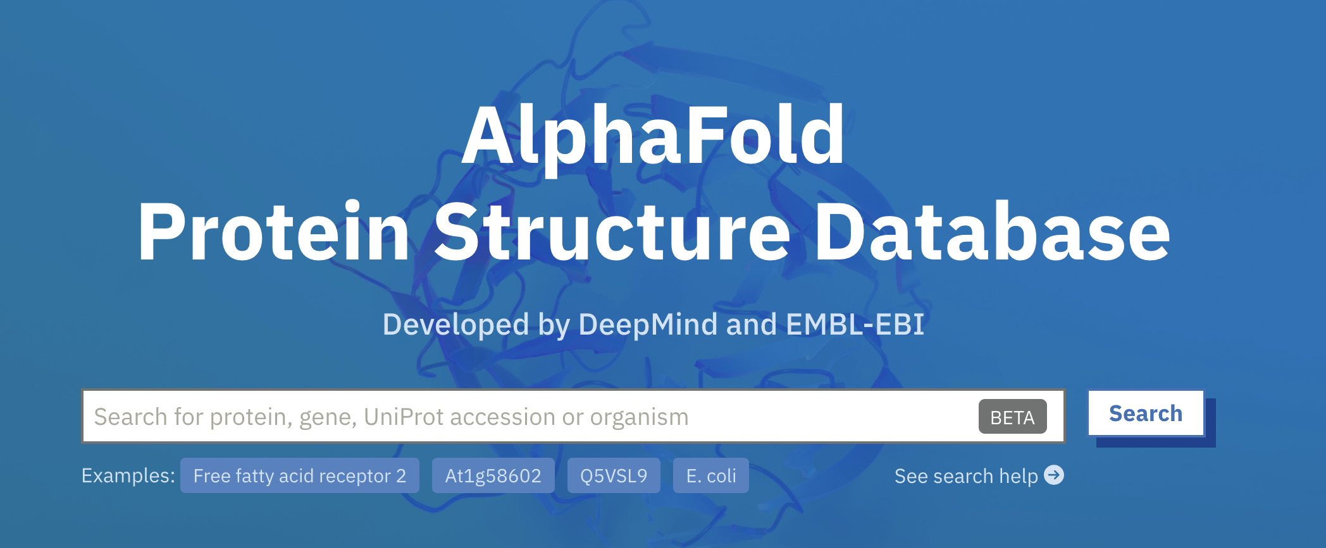
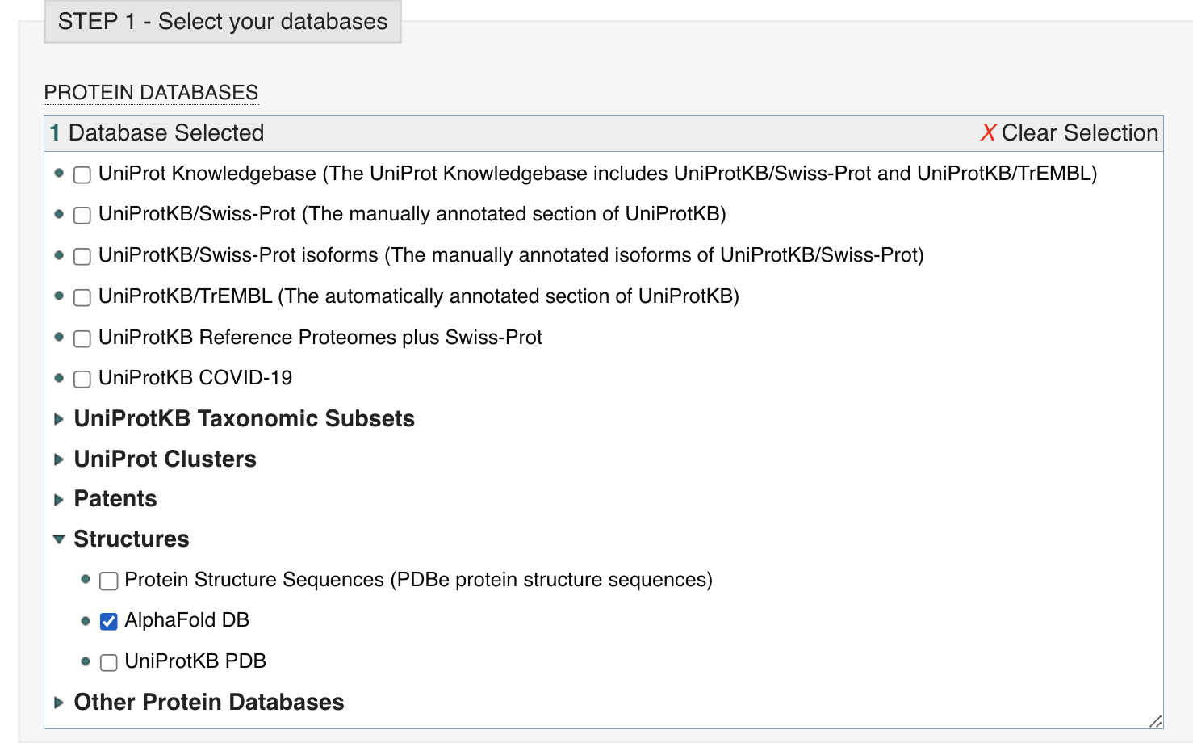
How to use Alaphfold to search protein structure: 1. If know the protein ID/name: https://alphafold.ebi.ac.uk/
Directly search it.
2. If it cannot be found, could try use sequence: Use FASTA tool to search: https://www.ebi.ac.uk/Tools/sss/fasta/

Slide 42
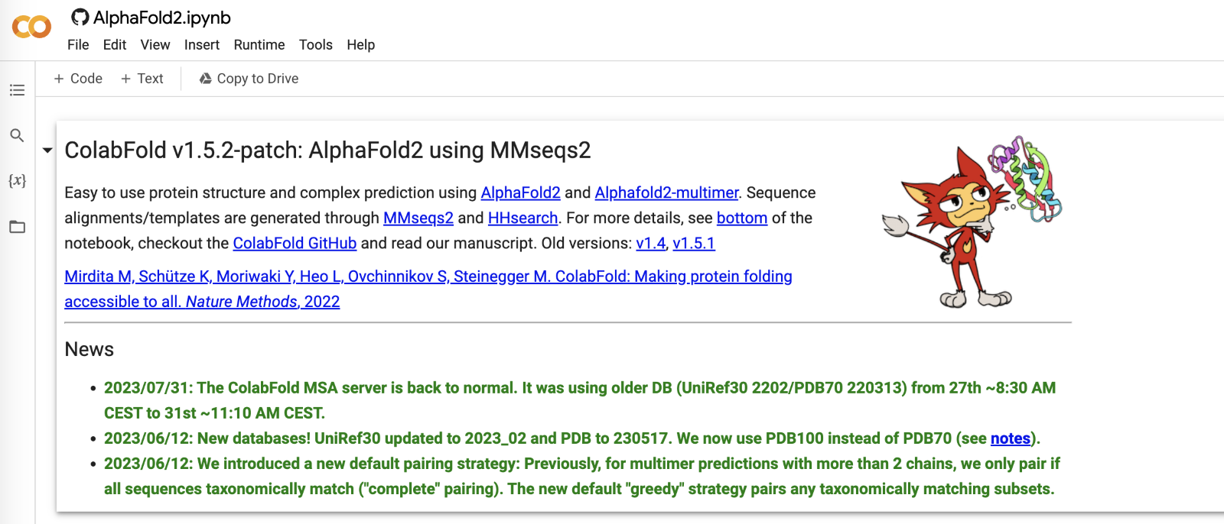
How to use Alaphfold to search protein structure:
3. Try google colab: https://colab.research.google.com/github/sokrypton/ColabFold/blob/main/AlphaFold2.ipynb

Slide 43
Any questions?

